Slide 1
FIRST YEAR PARENTS’ CHECK IN EVENING
NOVEMBER 11TH 2021

Slide 2

TEAM

Slide 3
FIRST YEAR TEAM
PRINCIPAL – Ms Dargan
DEPUTY PRINCIPALs- Ms Molamphy (FIRST YEARS)
Mr Clarke
Ms Moran
YEAR HEAD – Ms Morrissey
TUTORS
1C- Mr Cogavin
1D – Mr Maguire
1F – Mr Jones
1J – Ms Murphy
1M – Ms O’Brien
Chaplain- Ms C Clarke
Guidance – Ms Keane

Slide 4

SUPPORTS

Slide 5
Supports
Subject Teacher
Tutor
Year Head
Deputy Principal/ SNA
Guidance Counsellor
Designated Liaison Person – Principal Ms Dargan
Deputy Designated Liaison Person – Deputy Principal Mr Clarke

Slide 6

COMMUNICATION

Slide 7
COMMUNICATION PROTOCOLS
CLASSROOM – TEACHER –teachers may contact you regarding how the student is doing, behaviour, homework concerns etc
PASTORAL – TUTOR- tutors from time to time may check with parents regarding your son/daughter
YEAR HEAD- Year Head’s contact parents regarding several issues- pastoral, concerns, behaviour, incidences
DEPUTY PRINCIPAL/ PRINCIPAL -if any issue has arisen that requires the attention of Senior Management, the Deputy Principal or Principal will be in touch or arrange a meeting.
If you as the parent/guardian want to make an appointment, speak with a teacher, senior management or have any issues of concerns, please contact the Office at (01)8038056 or email www.admin@portmarnockcommunityschool.ie
The Office will forward your email or message to the parties concerned.
Allow time for teachers to get back to you

Slide 8
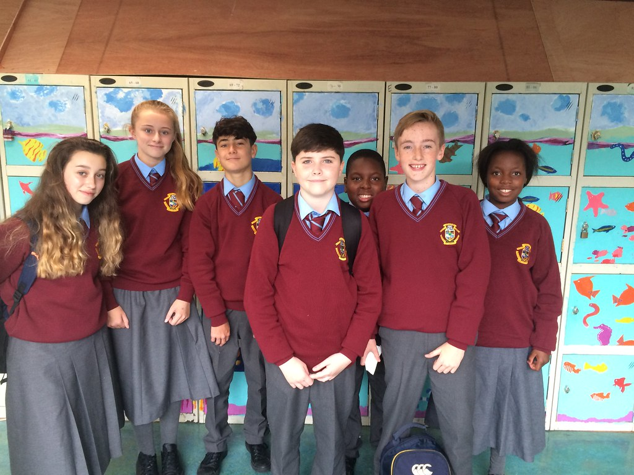

UNIFORM

Slide 9
ROLES AND RESPONSIBILITIES- UNIFORM
SCHOOL JUMPER, SHIRT, TIE AND TROUSERS
SCHOOL JACKET- TO BE WORN AT ALL TIMES, INCLUDING ON PE DAYS
SCHOOL SHOES- LEATHER OR LEATHER LOOK SHOES
CURRENTLY UNDER COVID RESTRICTIONS- STUDENTS WEAR PE GEAR IN ON PE DAYS AND TRAINING DAYS, SCHOOL JACKET MUST BE WORN ON THESE DAYS.
COVID RESTIRCTIONS- ALL WINDOWS, DOORS AND EXTERNAL DOORS MUST BE OPEN- THERMALS, NO HOODIES TO BE WORN WITH THE SCHOOL UNIFORM
MAKEUP, FALSE TAN, FACE PIERCINGS, ANY FORM OF FALSE NAIL, NAIL VARNISH- NOT PERMITTED
HAIR A NATURAL COLOUR
CLEAN SHAVEN, SINGLE STUD EARRINGS, IN BOTHE EARS OR A PAIR OF SLEEPER EARRINGS. IN BOTH EARS

Slide 10
My appearance:
I will have my full uniform on every day. Plain black leather/leather look shoes. Put your name on everything.
I will wear my school jacket at all times, even on PE days. No non-uniform jackets will be worn. Any non-uniform jackets will be confiscated.
My hair will be a natural colour. Boys will be clean shaven. One pair of plain stud earrings. No nose or body piercings. No make-up. No false eyelashes, false nails, tan or nail varnish.
If Covid Protocols are still in place PE gear can be worn on PE days only.
I will wear my uniform on school trips, to represent my school with pride.

Slide 11
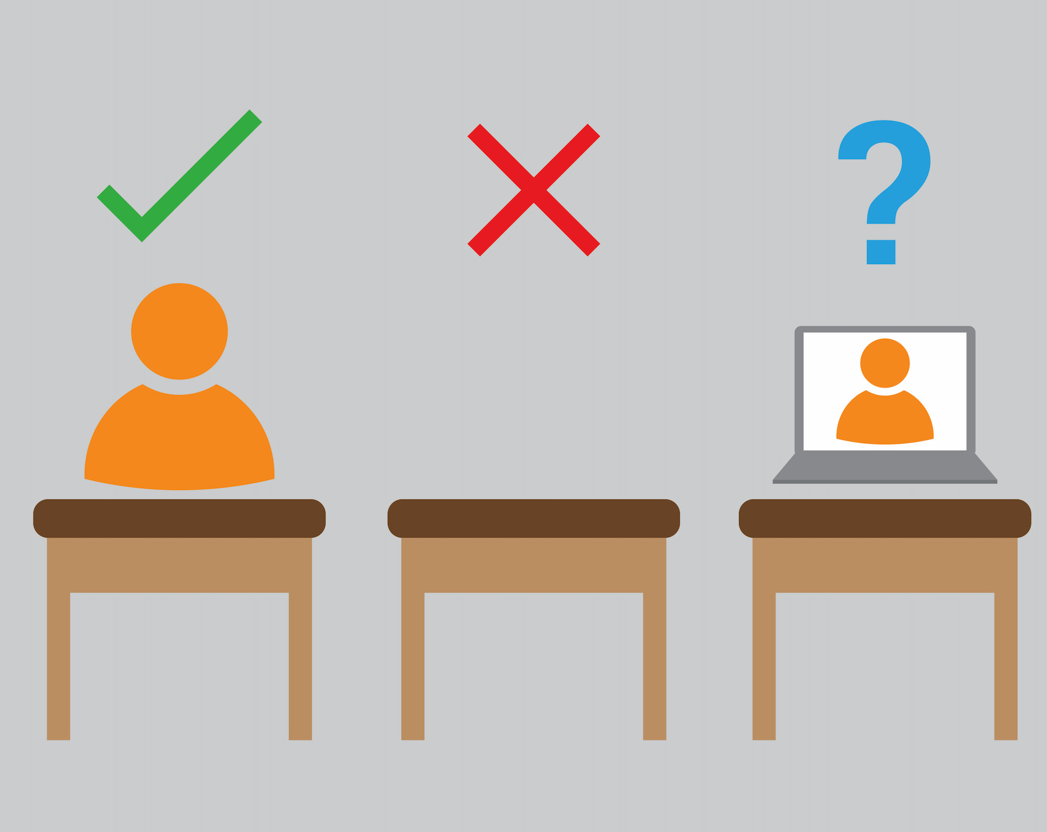
ATTENDANCE

Slide 12
EDUCATION AND WELFARE ACT
PROVIDE A NOT OF EXPLANATION FOR ABSENCE, USUALLY IN THE JOURNAL, UNDER CURRENT RESTRICTIONS- EMAIL TO THE MAIN OFFICE
www.admin@portmarnockcommunity school.ie
THESE WILL THEN BE MARKED ON VSWARE
UNEXPLAINED ABSENCES
PROCEDURE FOR GOING HOME UNWELL
APPOINTMENTS- email the main office, note in journal, same procedure for leaving
STUDENTS ARE NOT ALLOWED TO LEAVE THE SCHOOL WITHOUT PERMISSION
STUDENTS SHOULD NOT TEXT HOME TO REQUEST TO LEAVE
ANY STUDENT, NOT FROM PORTMARNOCK, MUST REMAIN ONSITE ALL DAY- INCLUDING LUNCH TIME AND BREAK TIME
ALL FIRST, SECOND AND THIRD YEAR STUDENTS ARE NOT PERMITTED TO DUNNES STORES, SPAR OR THE PSLC

Slide 13

VSWARE

Slide 14
Online system that records attendance
Parental access to view their son/daughter’s attendance and behaviour
Also provide parents with access to view term reports
If your son/daughter is late you will receive a text informing you
If you have not gained access, contact the office and they will inform you of your password.

Slide 15

MOBILE PHONES
ACCEPTABLE USE OF MOBILE PHONES
Students are only allowed to use their phones with permission from a teacher (ie- to access work)
If a student is using their phone without permission, be it in the classroom, bathrooms, at lunch, break time or anywhere onsite, the phone will be confiscated and held securely for a period of 24hrs.
Parents will be informed
Failure to hand over the phone will result in a suspension and the phone confiscated for a week.

Slide 16
Encourage and teach good and safe behaviours online
Good patterns with phone use in the evenings
No “banter”
Cyberbullying
Monitor Snapchat, WhatsApp groups
A lot of helpful information regarding “Examples of expected use” of phones- Journal page 30
Journal – pages 26 to 31 – relevant information regarding the safe useage of mobile phones

Slide 17

STUDENT’S RESPONSIBILITY- BEHAVIOUR FOR LEARNING

Slide 18
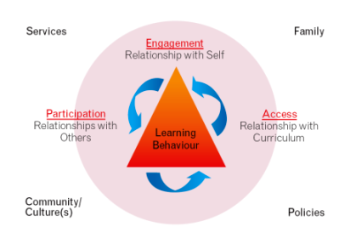

Slide 19
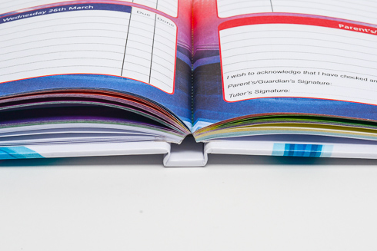
School journal and homework

Slide 20
Encourage good habits with regard to monitoring the journal
Students prepared and organised
Good homework habits
Routine
Study
Assessments
Behaviour for Learning
Respect

Slide 21
My classroom:
I will be ready for learning at the classroom door at 8.40 am and 1.55 pm. I will line up at the classroom door until the teacher arrives for each class (unless remaining in the class).
I will remain in my seat, prepare for my next class and behave while I am waiting for the teacher to arrive.
I will have all of the relevant books and materials for every class.
I will be punctual to every class on my timetable.
I will ensure that I follow all instructions given by my teacher.
I will ensure that I note all my homework into my school journal, before I leave the lesson.
I will be respectful when working with my teacher online.

Slide 22
I will ensure that I will be mindful of my behaviour to the teacher and other students, when I am on an online lesson.
I will be very respectful and kind when working in class, with another student(s).
I will have a note of explanation in my journal for any absences the next day.
I will ask the Principal, Deputy Principal or Year Head if I have to leave during the school day. If I feel sick I will not contact a parent/guardian myself but will go through the office.
If I have an appointment my parent/guardian will provide a note.
I must always sign out at the office if permission has been given to me; by a parent’s note, a teacher, Year Head or Deputy Principal; and a call has been made, by the school, to my parent/guardian informing them that I am leaving the school. If I do not follow these procedures, I may be liable to a suspension.

Slide 23
“How can I help my child succeed at secondary school?”

Slide 24
Encourage a ‘Growth Mindset’

Slide 25
Growth mind-set in action
Reading regularly
Arriving to lessons well-prepared
Maintaining excellent attendance
Home learning completed on time and to a high standard
Asking questions to improve understanding
Sharing ideas with others
Respond to teacher’s feedback in books and lessons
Never waste time talking in lessons
Find out how other people have achieved high marks
Reflect on success: What was it that made you succeed?

Slide 26
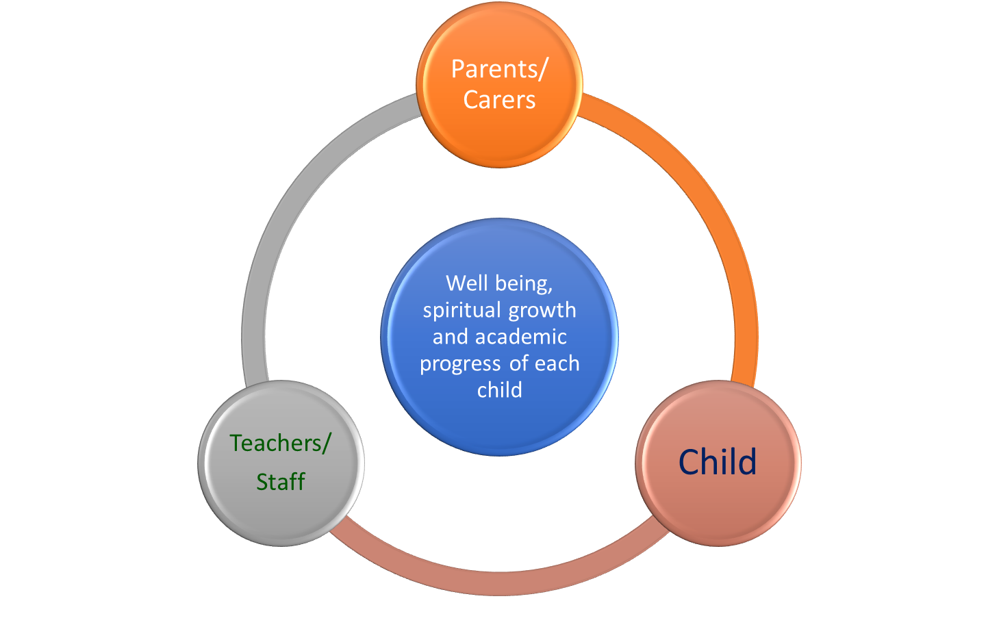

Continued partnership in education

Slide 27

COVID 19

Slide 28
COVID PROTOCOLS
Schools remain under the same protocols and restrictions as outlined since March 2020.
Physical distancing- 1m apart in class, 2m when mask off and outside
Wearing masks at all times
Hand sanitising
Learning hub
Google Classroom- accessible from any device
Lockers
Canteen

Slide 29


