Slide 1

A Guide to PLCs
Alternative Progression Routes to College

Slide 2
What are PLCs?
PLCs are Post Leaving Certificate Courses.
They are open to all Leaving Cert and Mature students.
(Interviews are held Feb-May).
Early application advised.
Application is through the individual colleges websites.

Slide 3

PLCs- Why apply?
Specialised courses
Job Focused
Many include work experience and have links to industry
Stepping stone to I.Ts/TUs and Universities
This Photo by Unknown Author is licensed under CC BY-NC

Slide 4
Stepping Stone Approach to 3rd Level.
Many courses on the CAO reserves places for PLC entrants.
Whilst many courses offer places, there are a few caveats/considerations to bear in mind….
Not all courses have QQI pathways (i.e. PLC Links)
Students must obtain certain grades in their PLC course to qualify for applying (It is not a guaranteed route).
Check with the HEI regarding the CAO course your child is interested in to determine how many places they allocate for PLC entrants. (This can help with expectations).

Slide 5
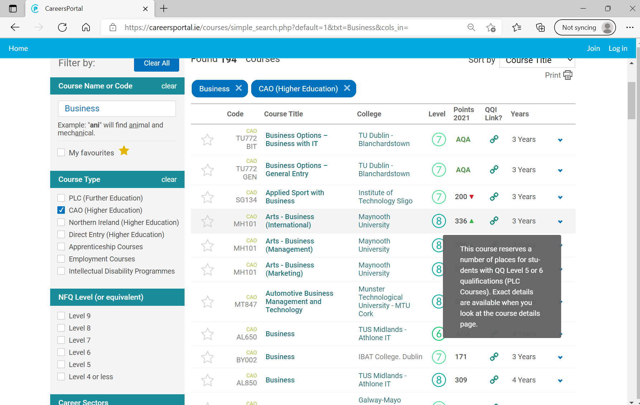
How do I know what courses have QQI links (PLC link)?
Go to Careersportal.ie
Type in the name of the course e.g. Business
Once you see a link under the QQI heading, you know it accepts PLCs as a progression route.

Slide 6
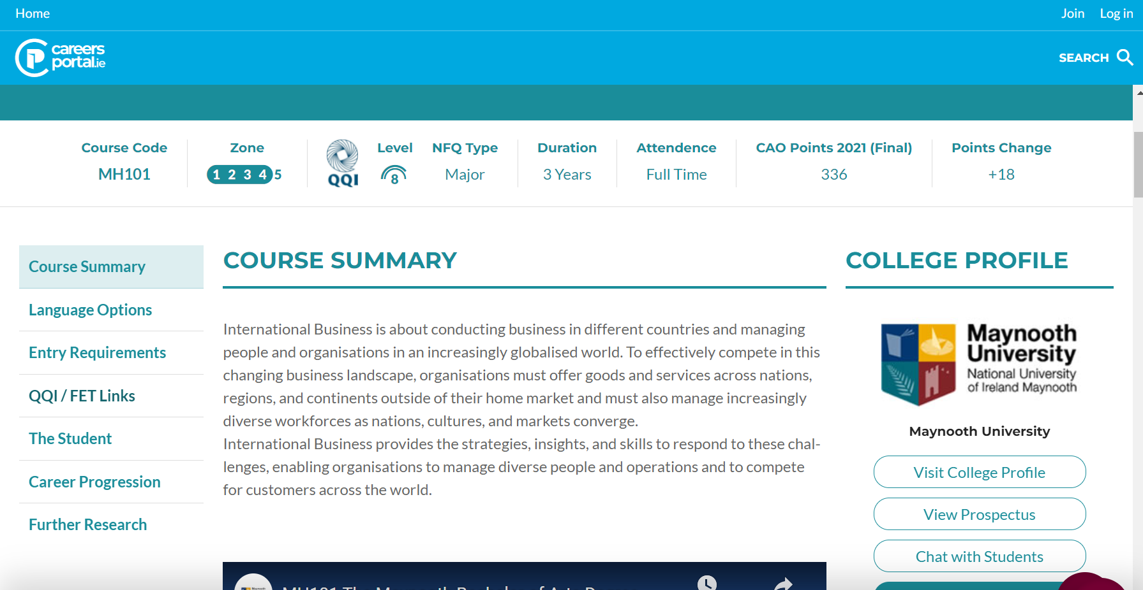
For the purpose of illustration, I clicked on (Arts) International Business in Maynooth, as was listed on the previous slide. This brings you to the course page on Careers Portal. You will see from the arrow below that there is a section for QQI links, click on this………

Slide 7
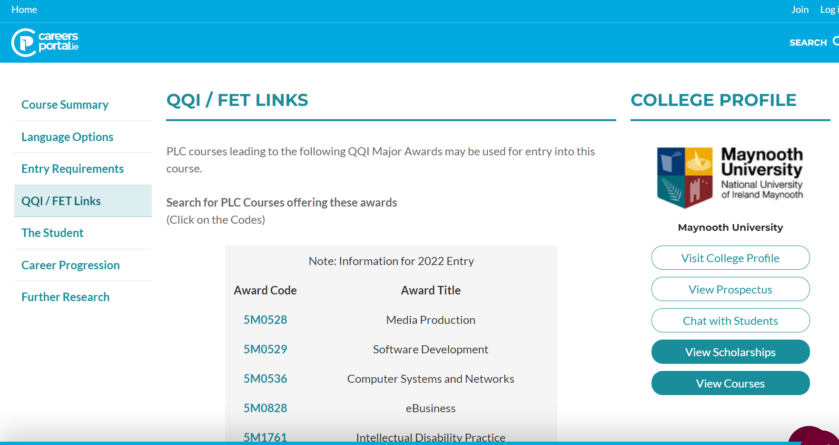
If you click on any of the codes listed below, it will provide a list of courses that will be accepted for QQI (PLC) entry route.

Slide 8
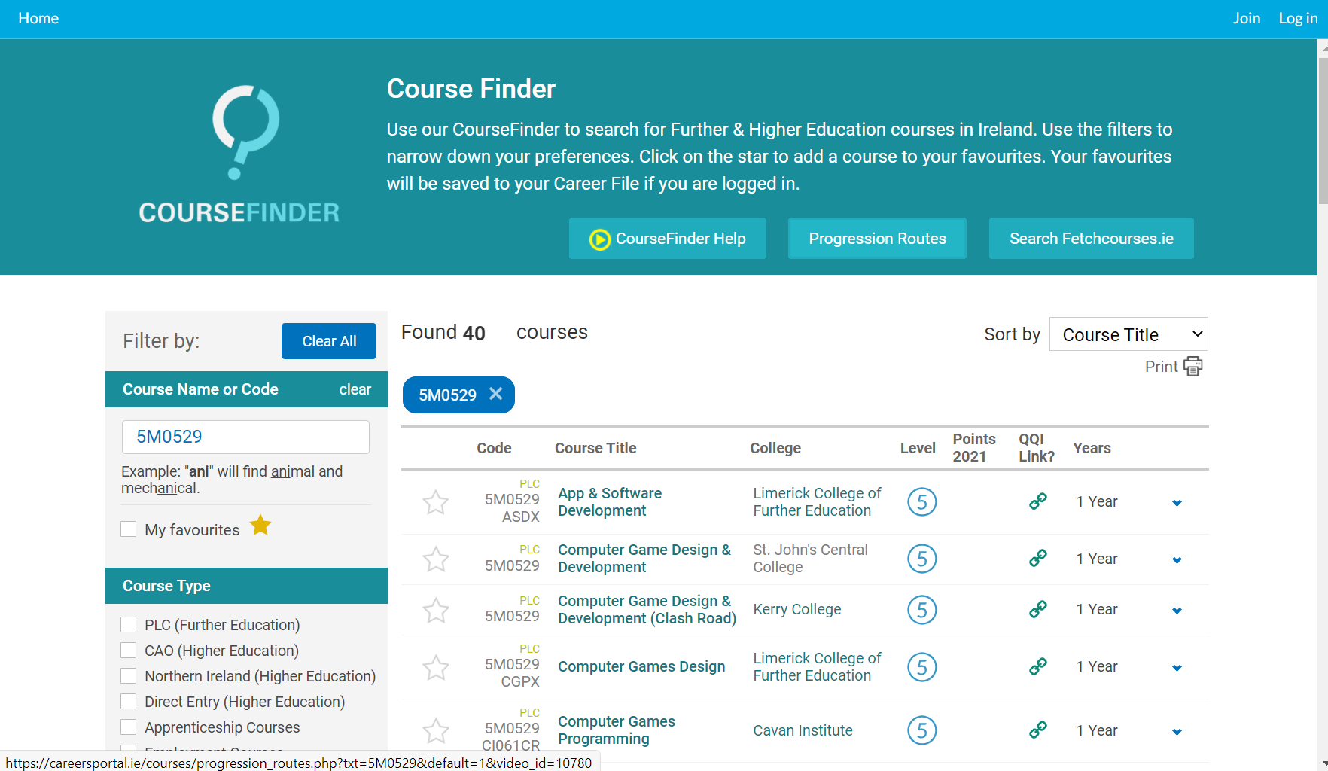
When I clicked on one of the codes listed on the previous page, it provided me with a list of all the PLC courses options that will satisfy for a QQI entry route to the Arts (International Business course in Maynooth University).
Please note the heading for Progression Routes… this lists all the courses on the CAO that have progression routes.
**As CareersPortal.ie is a Third Party site, I would double check everything on the CAO site to ensure it is 100% accurate.

Slide 9
Summary
You apply directly to each individual course/college through their website.
If accepted, they will usually require a deposit, which varies between colleges. (Usually it is about €40-€50). Many colleges refund this , should you decide not to accept your offer in September.
You can still qualify for the SUSI maintenance grant. (I.e. the monthly payment to help with the cost of studying).
It is not a guaranteed entry route.
If you do not satisfy the 3rd language requirement for an NUI college, this can be a way of bypassing this rule….PROVIDING the course has a QQI link and you achieve the necessary grades.

Slide 10
Higher Education Links
Some HEIs have specific courses that are linked to Level 5 & 6 PLC courses.
Full award from single sitting - 8 components – minimum 5 distinctions with specific component requirements.
These are added up to give a total of 400 points. Places reserved for FETAC (PLC Entrants) are then awarded a place based on their results, in order of merit.
(Please note that some colleges, such as NCI do not require any distinctions for their level 6/7 courses and in some cases accept ANY PLC course for entry to their courses).

Slide 11
Questions?
If you have any questions regarding any of the information from Thursday’s CAO Talk or from the information in this Powerpoint, then please do not hesitate to contact either:
bcoggins@portmarnockcommunityschool.ie
ffarrell@portmarnockcommunityschool.ie
Many thanks for joining us for the CAO talk on Thursday, we hope you found it helpful.

