Slide 1


Slide 2

First Year Team
PRINCIPAL – Ms Dargan
DEPUTY PRINCIPALS- Ms Moran (FIRST YEARS)
Mr Clarke
Ms Molamphy
YEAR HEAD – Mr. Redmond
TUTORS
CHAPLAIN- Ms C. Clarke
GUIDANCE COUNSELLORS
SPECIAL EDUCATION – Ms C. Cronin

Slide 3

Supports
Subject Teachers
Tutor
Year Head
Deputy Principal
Special Education Needs Department
Guidance Counsellors & Chaplain
Designated Liaison Person – Principal, Ms Dargan
Deputy Designated Liaison Person – Deputy Principal, Mr Clarke

Slide 4

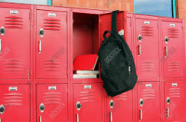
First Year Induction
Assemblies & Introductions
Tutor Groups – Timetable
Buddy System – School Tour
Lockers
Advice from First Years
Friendship Week
Prefects & Student Council

Slide 5

The School Day
8.40am Bell – at class with books etc
4 classes (40 mins each) – break from 11.25 – 11.35
2 classes (40 mins each) – Lunch from 12.55 – 1.55
Bring or buy lunch
Permission to go home – by agreement with school
No permission to go to Dunnes, SPAR or PSLC etc
3 classes (40 mins each)
School finishes at 3.55pm

Slide 6







Other Areas of Learning
Get involved
Skills
Social
School Identity
Wide Variety
Student Council

Slide 7
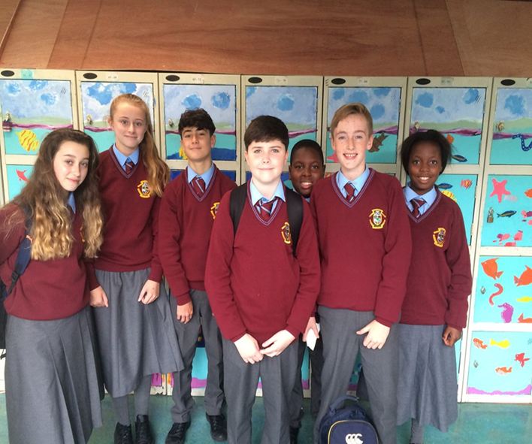
Uniform
SCHOOL JUMPER, SHIRT, TIE, TROUSERS/SKIRT, BLACK LEATHER OR LEATHER LOOK SHOE, SCHOOL JACKET
Label everything!
Appearance Rules –
  Make-Up, False tan, Face piercings, any form of false nail, Nail Varnish
  Hair must be a natural colour
  EARRINGS – Single stud earrings in both ears or a pair of sleeper earrings in both ears
Outward expression of school identification

Slide 8

VSware System
Online system that records attendance
Parental access to view their son/daughter’s attendance and behaviour
Also provide parents with access to view Term Reports
If your son/daughter is late or absent from school you will receive a text informing you
Please ensure we have your correct phone number and email address

Slide 9


School Website
Code of Behaviour – Read with your son/daughter
Policies
Calendar, Activities, Meetings
Uniform, Booklist, Rules
Reflects our very active school community
Twitter @portmarnockcs
Facebook @PortmarnockCS

Slide 10
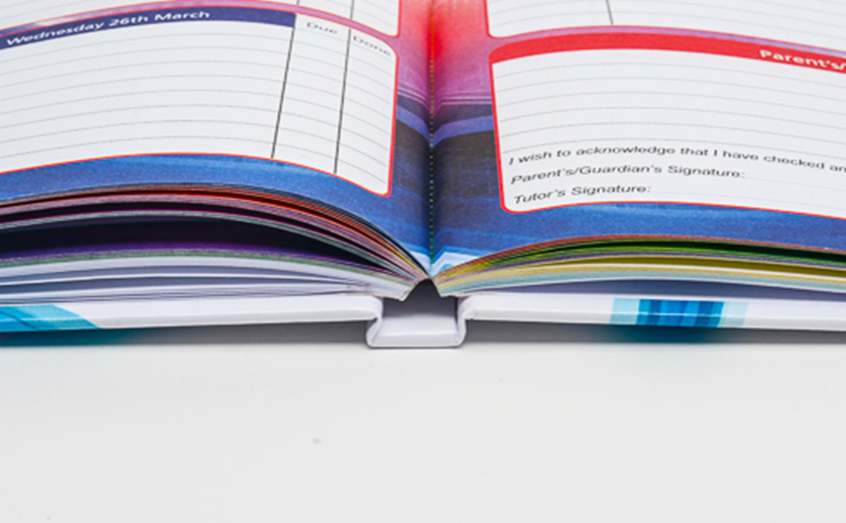
School Journal and Homework
Homework, signed, book check
Notes for absences, appointments etc
Notes from teachers
Permission to leave class/phone home
Learning advice & aids
Signed every night
Bought in school – pay online
Studyclix.ie account

Slide 11
CAT4 Assessment – 29 January 2022
9am – Saturday 29 January 2022 - PE Hall
Bring a pencil, pen, a ruler and an eraser
Students should wear their primary school uniform/ school tracksuit
Facial coverings must be worn by all
No food or drink
Assessment will be completed by 12.30pm HOWEVER it is recommended that parents/guardians are present to collect students from 12pm onwards

