Slide 1


Slide 2

First Year Team
ACTING PRINCIPAL – Mr Clarke
DEPUTY PRINCIPALS- Ms Molamphy (FIRST YEARS)
Ms Coleman (Acting)
Ms Moran
YEAR HEAD – Ms Norris
TUTORS
CHAPLAIN- Ms C. Clarke
GUIDANCE COUNSELLORS
SPECIAL EDUCATION – Ms C. Cronin

Slide 3

SUPPORTS

Slide 4

Supports
Subject Teachers
Tutor
Year Head
Deputy Principal
Special Education Needs Department
Guidance Counsellors & Chaplain
Designated Liaison Person – Acting Principal, Mr Clarke
Deputy Designated Liaison Person – Deputy Principal, Ms Molamphy

Slide 5
COMMUNICATION PROTOCOLS
CLASSROOM – TEACHER –teachers may contact you regarding how the student is doing, behaviour, homework concerns etc
PASTORAL – TUTOR- tutors from time to time may check with parents regarding your son/daughter
YEAR HEAD- Year Head’s contact parents regarding several issues- pastoral, concerns, behaviour, incidences
DEPUTY PRINCIPAL/ PRINCIPAL -if any issue has arisen that requires the attention of Senior Management, the Deputy Principal or Principal will be in touch or arrange a meeting.
If you as the parent/guardian want to make an appointment, speak with a teacher, senior management or have any issues of concerns, please contact the Office at (01)8038056 or email www.admin@portmarnockcommunityschool.ie
The Office will forward your email or message to the parties concerned.
Allow time for teachers to get back to you

Slide 6

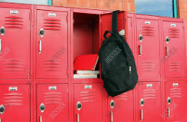
First Year Induction
Assemblies & Introductions
Tutor Groups – Timetable
Buddy System – School Tour
Lockers
Advice from First Years
Friendship Week
Prefects & Student Council

Slide 7

The School Day
8.40am Bell – at class with books etc
4 classes (40 mins each) – break from 11.25 – 11.35
2 classes (40 mins each) – Lunch from 12.55 – 1.55
Bring or buy lunch
Permission to go home – by agreement with school
No permission to go to Dunnes, SPAR or PSLC etc
3 classes (40 mins each)
School finishes at 3.55pm

Slide 8







Other Areas of Learning
Get involved
Skills
Social
School Identity
Wide Variety
Student Council

Slide 9
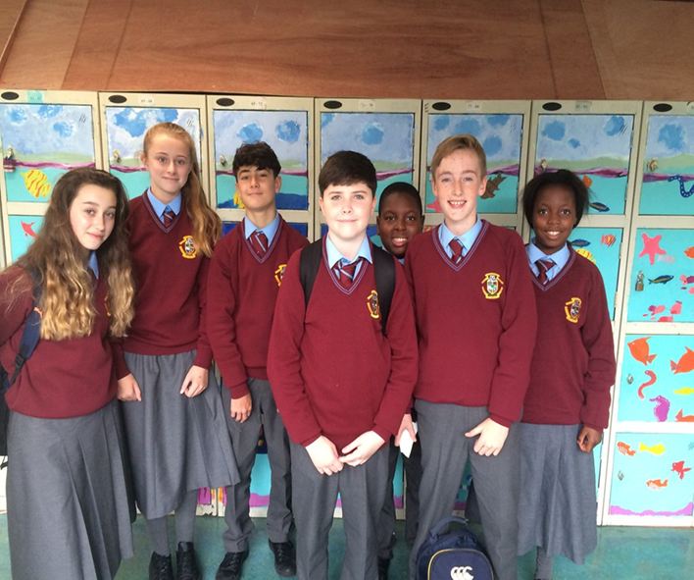
Uniform
SCHOOL JUMPER, SHIRT, TIE, TROUSERS/SKIRT, BLACK LEATHER OR LEATHER LOOK SHOES
SCHOOL JACKET: school jackets MUST be worn at all during the school day.
PE Uniform: PE uniform- now available, can be worn ONLY on PE days
Label everything!
Appearance Rules – will be in the school journal p. 8&9
There should be no
  Make-Up, False tan, Face piercings, any form of false nail, Nail Varnish
  Hair must be a natural colour
  Clean shaven
  EARRINGS – Single stud earrings in both ears or a pair of sleeper earrings in both ears
Outward expression of school identification

Slide 10

VSware System
Online system that records attendance
Parental access to view their son/daughter’s attendance and behaviour
Also provide parents with access to view Term Reports
If your son/daughter is late or absent from school you will receive a text informing you
Please ensure we have your correct phone number and email address

Slide 11
EDUCATION AND WELFARE ACT
PROVIDE A NOT OF EXPLANATION FOR ABSENCE, USUALLY IN THE JOURNAL, UNDER CURRENT RESTRICTIONS- EMAIL TO THE MAIN OFFICE
www.admin@portmarnockcommunity school.ie
THESE WILL THEN BE MARKED ON VSWARE
UNEXPLAINED ABSENCES
PROCEDURE FOR GOING HOME UNWELL
APPOINTMENTS- email the main office, note in journal, same procedure for leaving
STUDENTS ARE NOT ALLOWED TO LEAVE THE SCHOOL WITHOUT PERMISSION
STUDENTS SHOULD NOT TEXT HOME TO REQUEST TO LEAVE
ANY STUDENT, NOT FROM PORTMARNOCK, MUST REMAIN ONSITE ALL DAY- INCLUDING LUNCH TIME AND BREAK TIME
ALL FIRST, SECOND AND THIRD YEAR STUDENTS ARE NOT PERMITTED TO DUNNES STORES, SPAR OR THE PSLC

Slide 12

MOBILE PHONES
ACCEPTABLE USE OF MOBILE PHONES
Students are only allowed to use their phones with permission from a teacher (ie- to access work)
If a student is using their phone without permission, be it in the classroom, bathrooms, at lunch, break time or anywhere onsite, the phone will be confiscated and held securely for a period of 24hrs.
Parents will be informed
Failure to hand over the phone will result in a suspension and the phone confiscated for a week.

Slide 13
Encourage and teach good and safe behaviours online
Good patterns with phone use in the evenings
No “banter”
Cyberbullying
Monitor Snapchat, WhatsApp groups
A lot of helpful information regarding “Examples of expected use” of phones- Journal page 30
Journal – pages 26 to 31 – relevant information regarding the safe useage of mobile phones

Slide 14


School Website
Code of Behaviour – Read with your son/daughter
Policies
Calendar, Activities, Meetings
Uniform, Booklist, Rules
Reflects our very active school community
Twitter @portmarnockcs
Facebook @PortmarnockCS

Slide 15
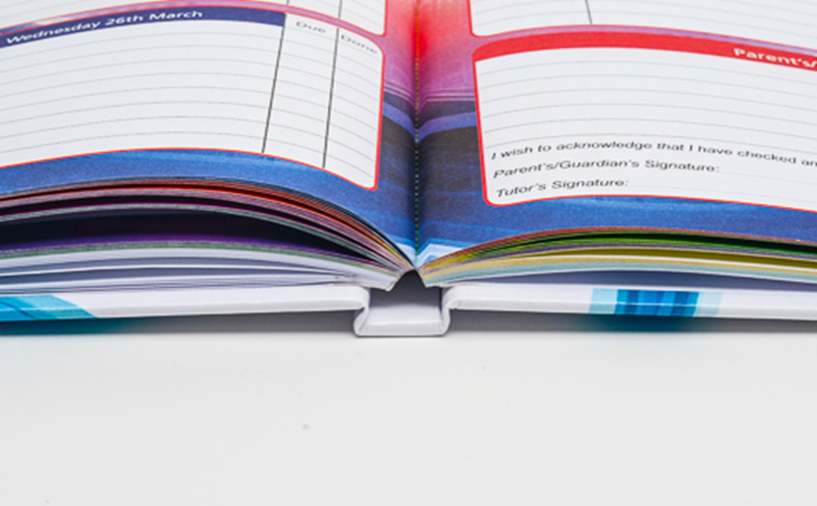
School Journal and Homework
Homework, signed, book check
Notes for absences, appointments etc
Notes from teachers
Permission to leave class/phone home
Learning advice & aids
Signed every night
Bought in school – pay online
Studyclix.ie account

Slide 16

Subject options

