Slide 1
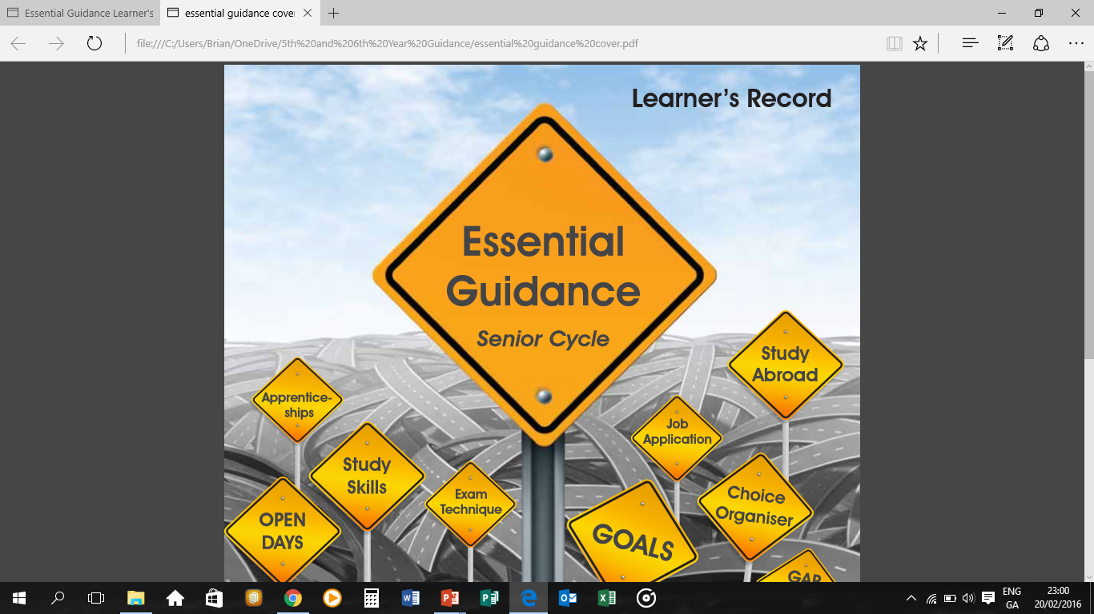
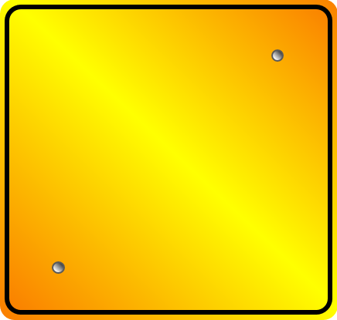
Parents’ Night
Subject Choice
2024

Slide 2


Leaving Cert Subject Choice
Things to consider!!
F. Farrell/B. Coggins
Guidance Counsellors
Portmarnock Community School

Slide 3
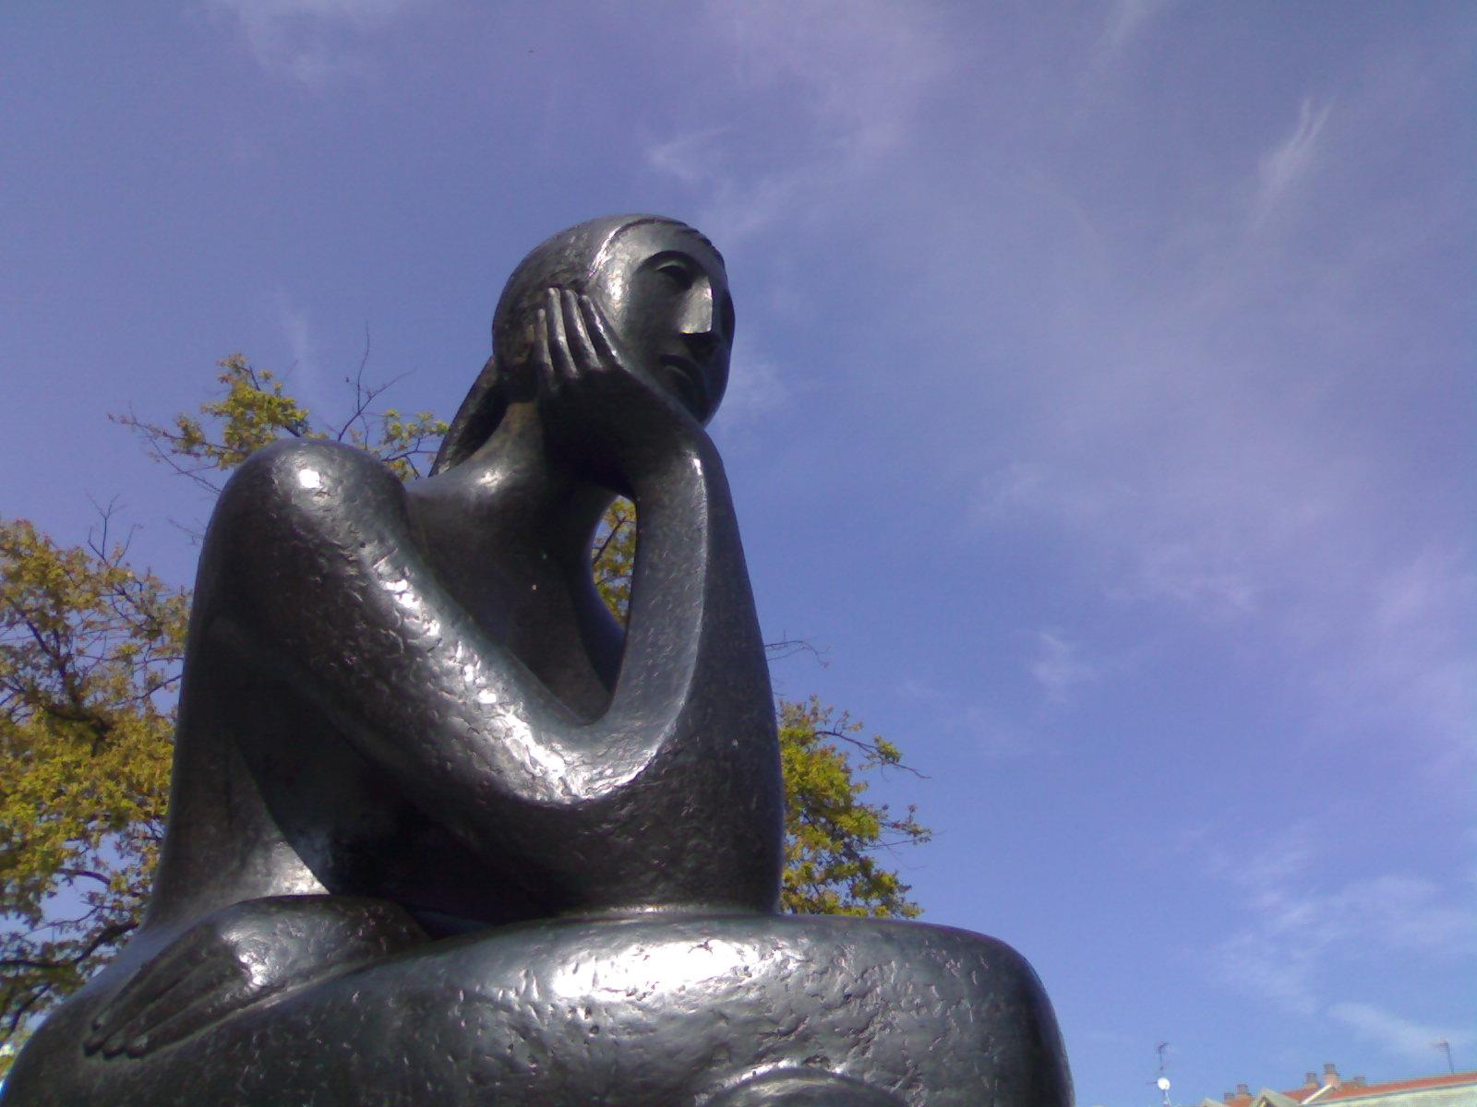
Consider the following factors when choosing your subjects:

Slide 4

Do you enjoy the subject?

Slide 5
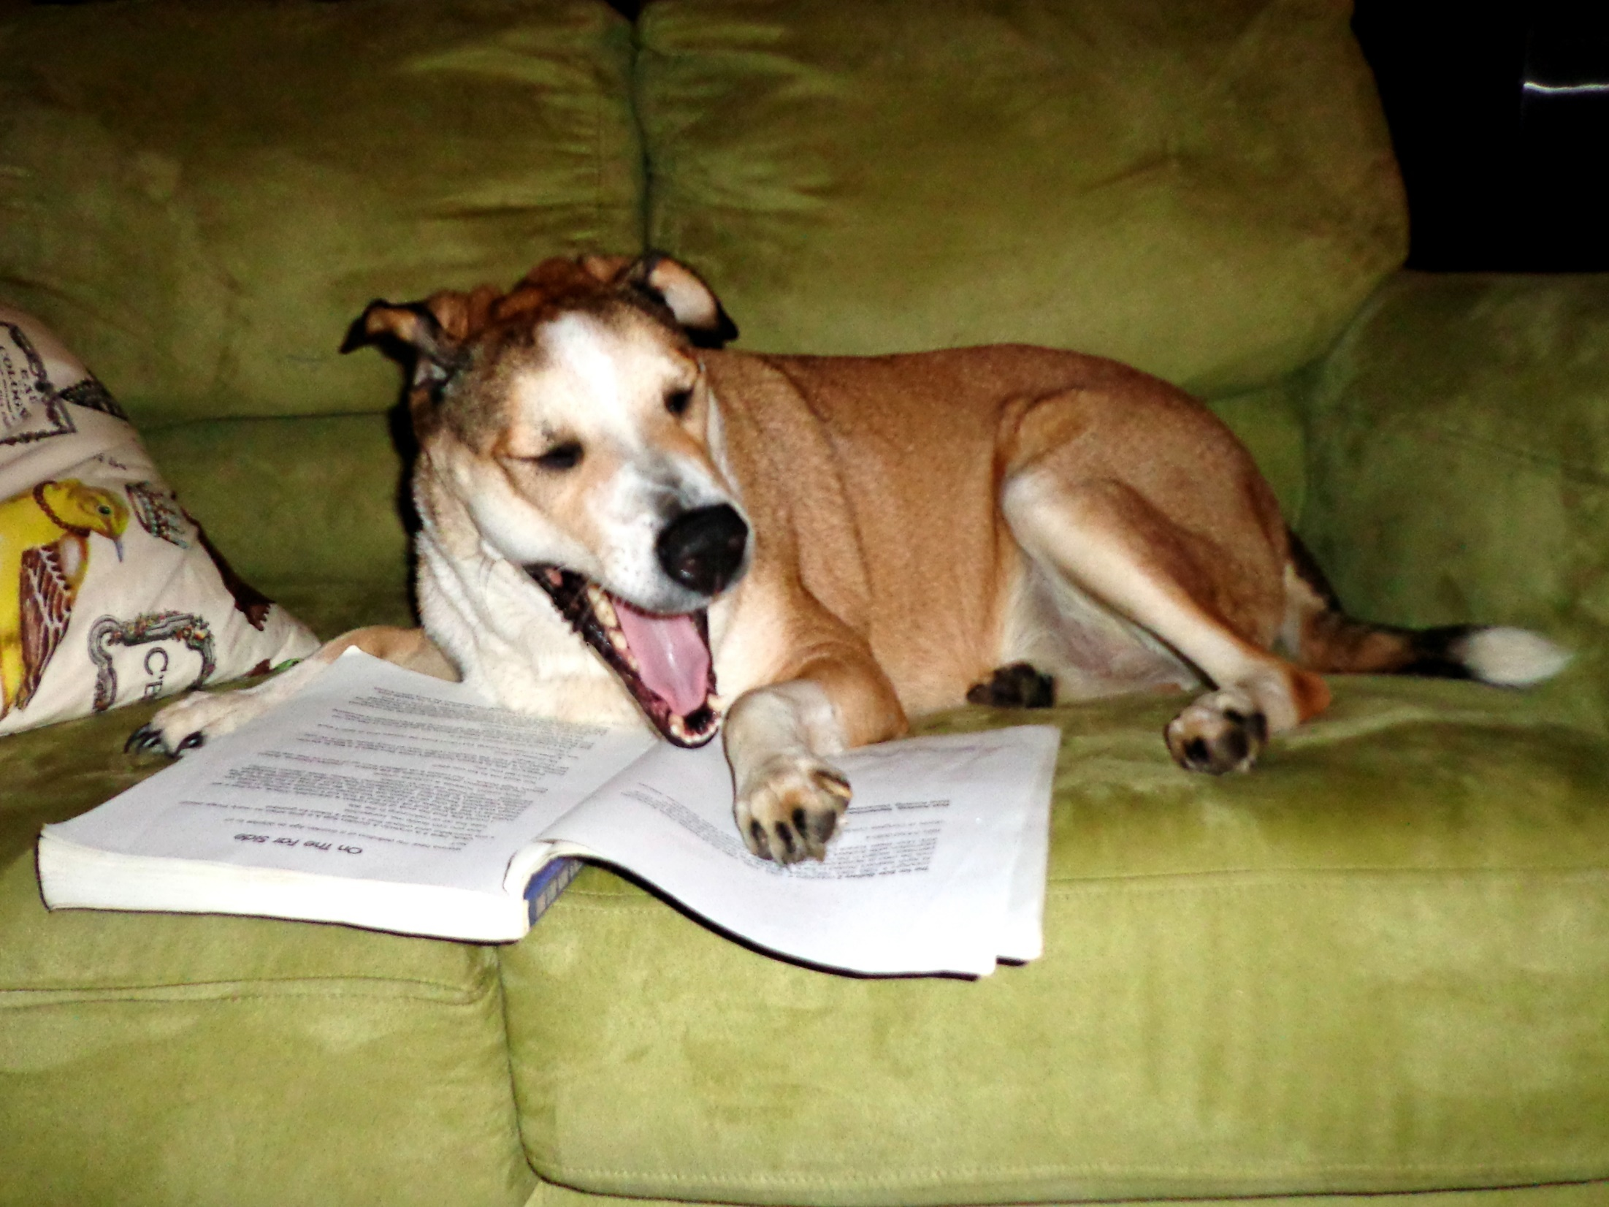
Are you interested?

Slide 6
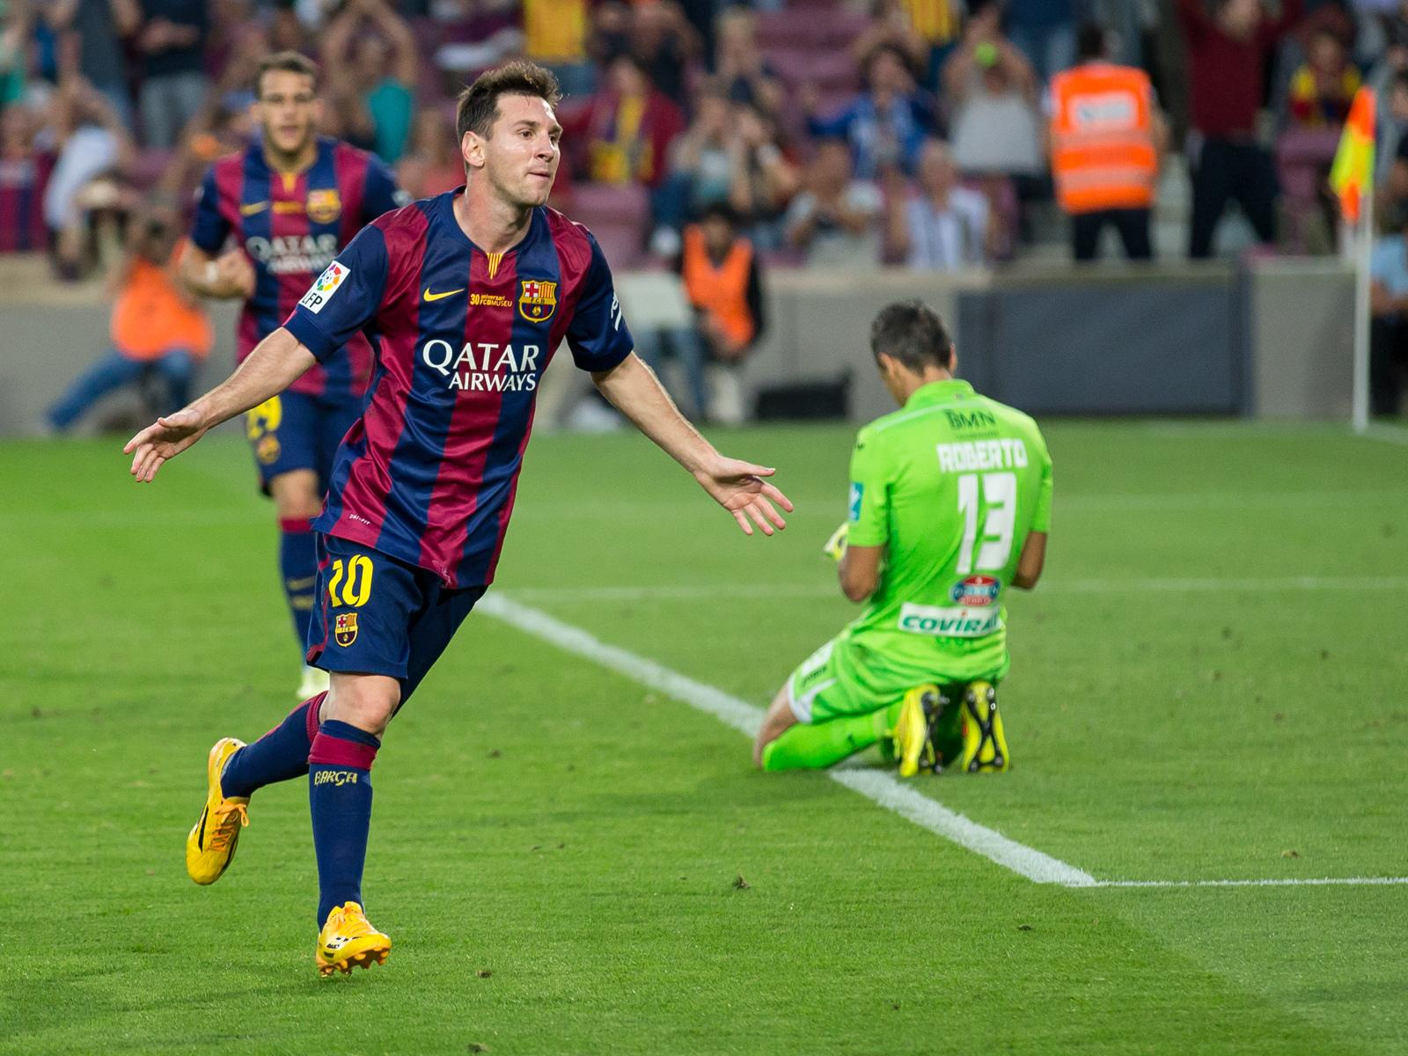
Does it come easy to you?

Slide 7

Things not to do when choosing subjects…

Slide 8
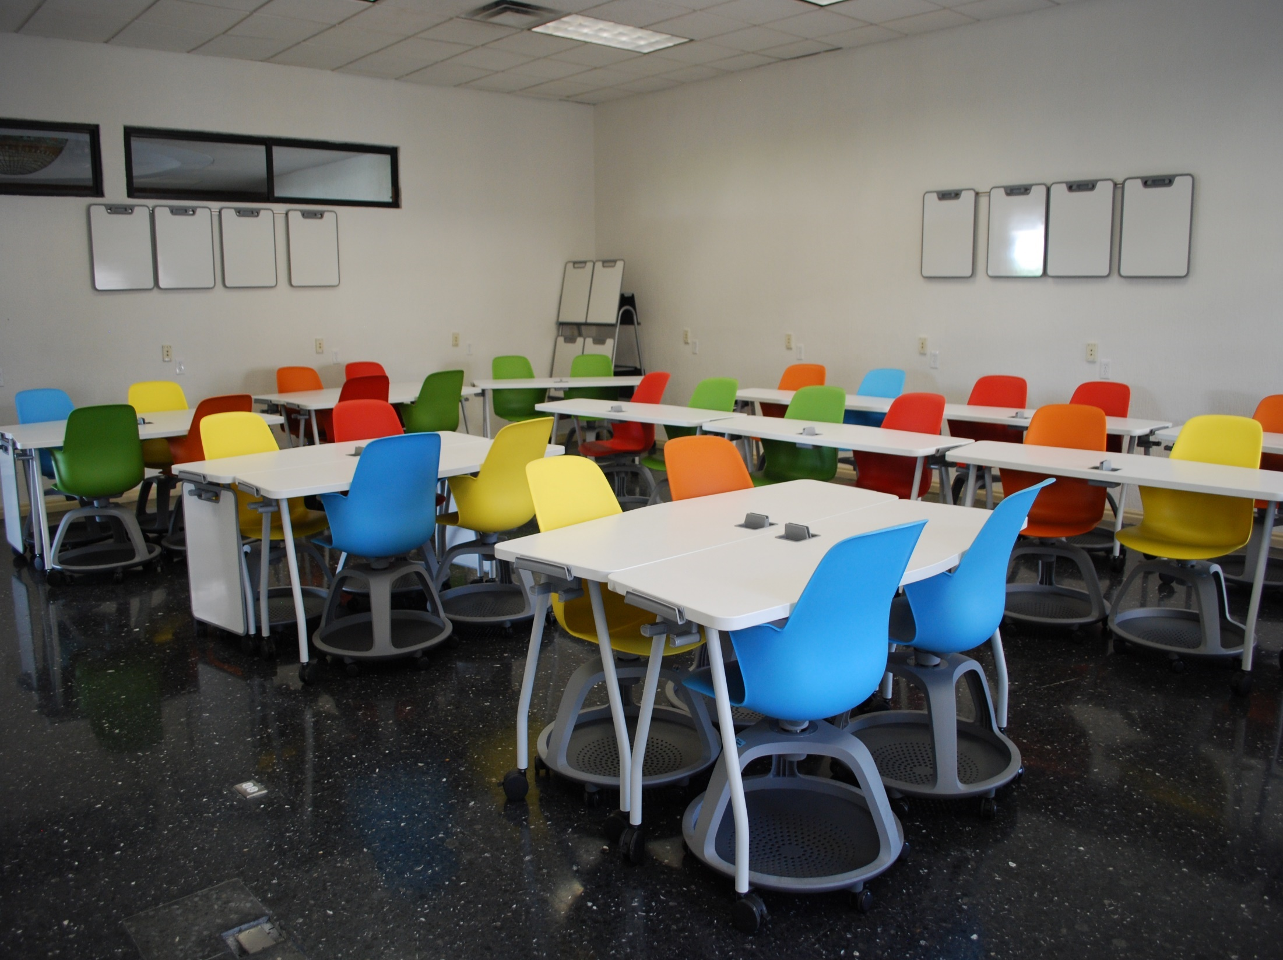
Thinking you can mess in that teacher’s class.
You will learn very little. You will regret it!!

Slide 9

All my friends are choosing that subject…
Think for
yourself !!!!

Slide 10
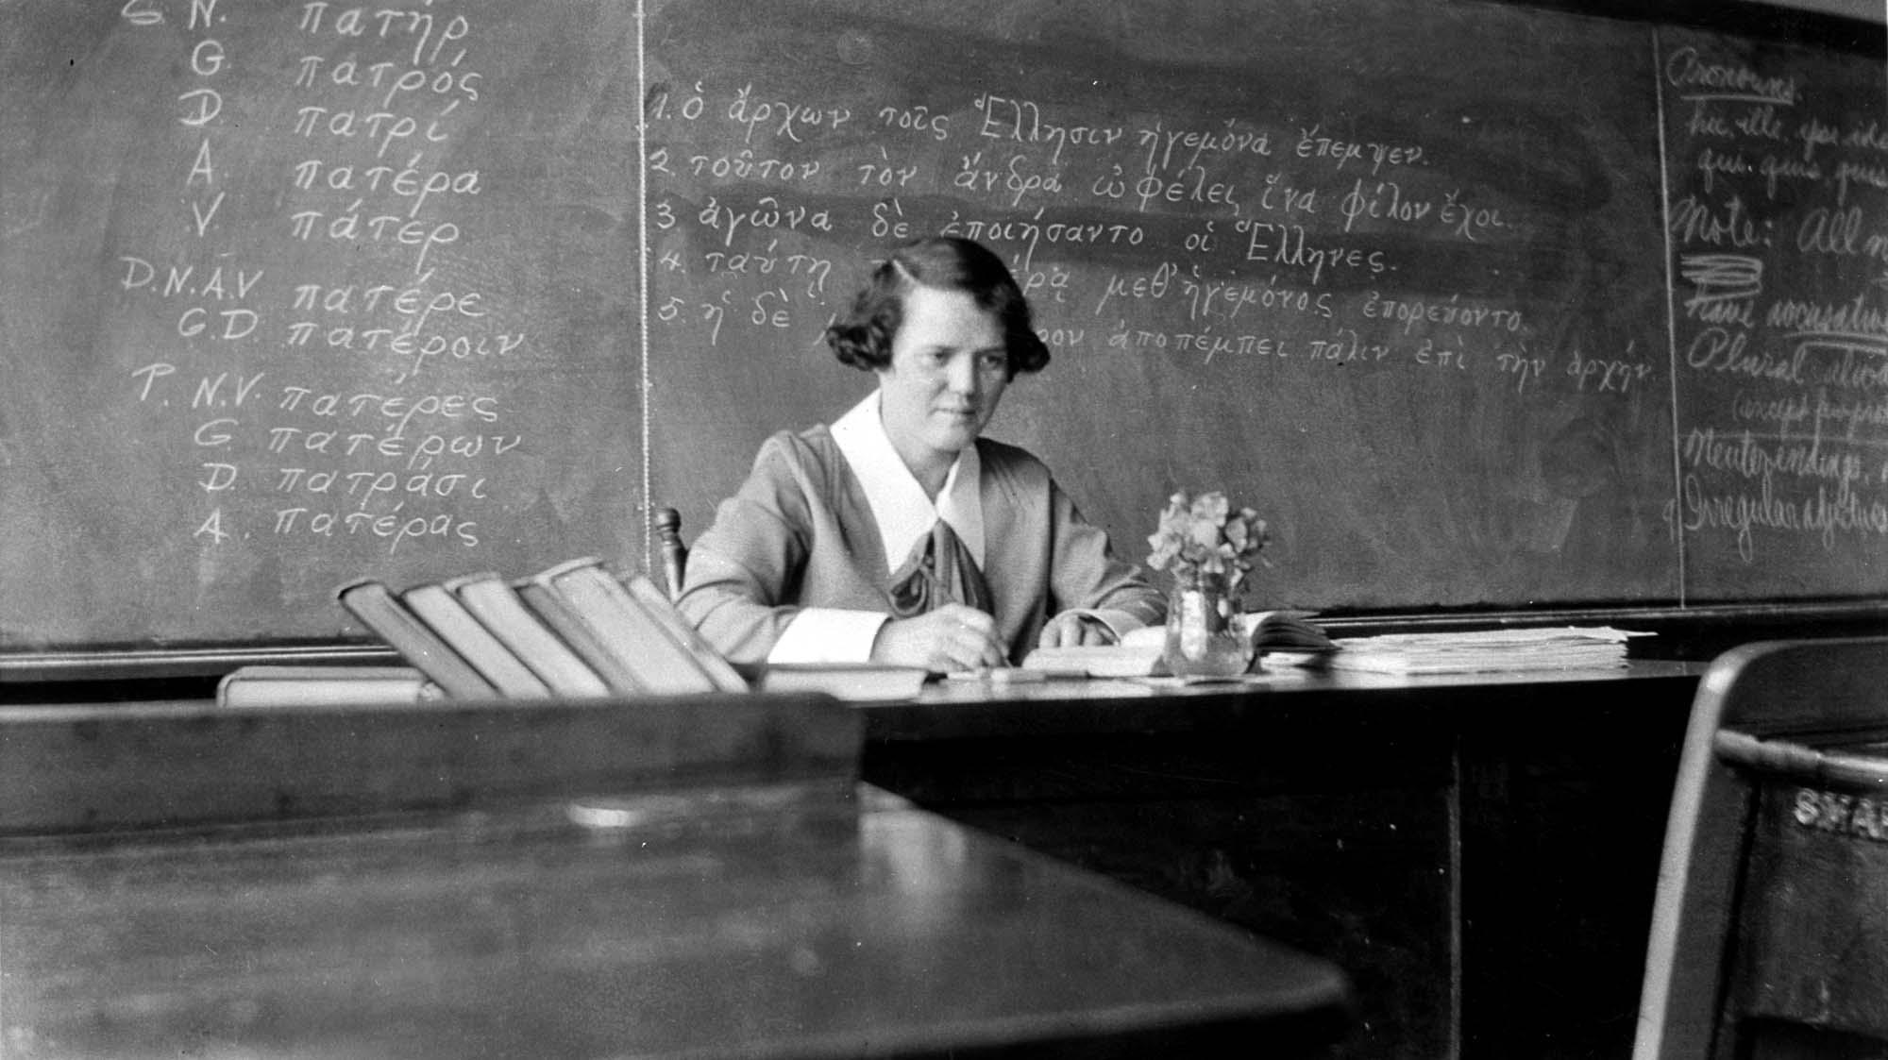
You like the teacher…
Make sure you like the subject also.
(Teachers can be switched or leave!!)

Slide 11
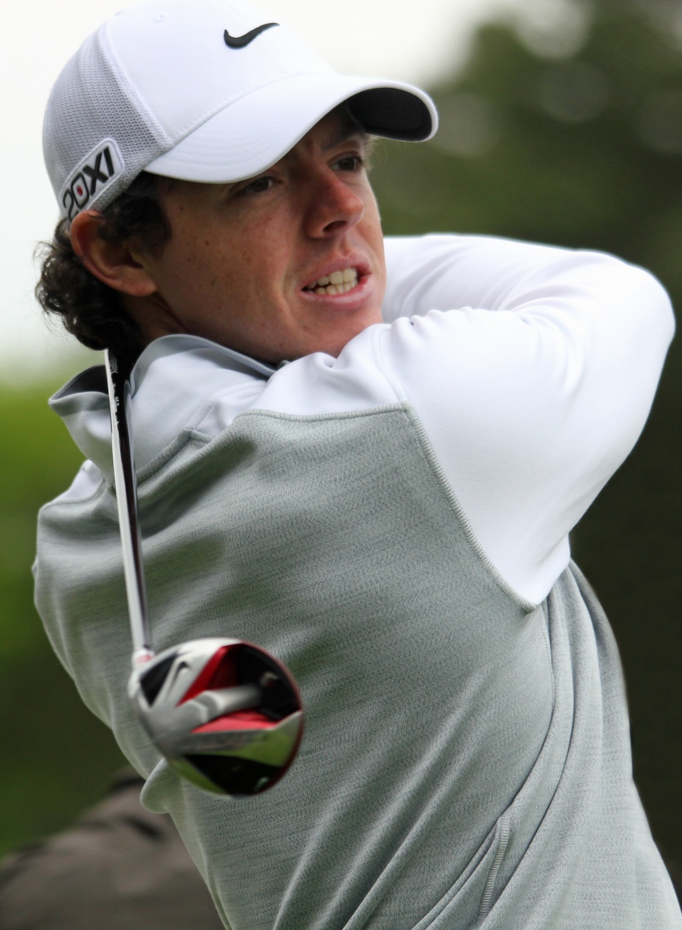
When choosing subjects, do what comes naturally.
It is easier and more comfortable for you.
Why make your life more difficult?

Slide 12
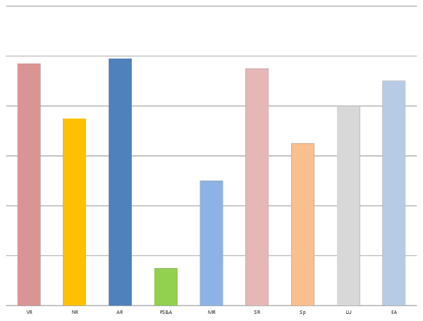
Aptitudes
All students have different strengths.
Choose subjects in which you are likely to get good grades. Check your DATS scores also.
You are also more likely to want to continue with these subjects when you leave school.

Slide 13

Your Favourite Subjects
favourite subjects from your Junior Cert
Not including Maths, Irish or English.

Slide 14

Career & Further Education
Apart from Irish, English and Maths, other subjects can be required for some courses & careers.
Check out these subject requirements with a Guidance Counsellor or the course provider.
IT IS YOUR CHILD’s RESPONSIBILITY TO DO THIS.

Slide 15
Options area
Four areas to choose from
Business area (accountancy, business, economics).
Sciences (physics, Biology, chemistry, Applied Maths*, Geography, LCPE, (new subject).
Technology area: (Engineering, construction, DCG). Technology itself is not available as an option for the LC.
Humanities: Art, Languages (French, Spanish, German), Music, Home Economics, History, Politics and Society).
YOU ARE NOT OBLIGATED TO CHOOSE A SUBJECT OR SUBJECTS FROM EACH GROUP HOWEVER.
* Applied Maths may be offered subject to teacher availability.

Slide 16
Choosing your options
Number of Subjects
Each student will study 4 optional subjects taken from any OR all of the four main areas.
It is possible to study a number of subjects in a similar subject area i.e. accountancy, business and economics.
Students wishing to study Applied Maths, Physics or Chemistry should have reasonably strong mathematical aptitudes.
It is advisable but not mandatory that students choose a modern language. Students may choose to study TWO modern foreign languages if they so wish.

Slide 17

THE SCIENCES
A pass in at least one Laboratory Science subject is needed if you are applying for anything in:
Engineering | Pharmacy
Human Nutrition/ Dietician | Medical Laboratory
Paramedical | Podiatry
Radiography | Veterinary
Physiotherapy | Nursing
Medical | Science areas at Universities
Physical Ed. + Maths (DCU) | Design & Manufacture (UL)
Both require a science subject.
i.e: Biology, Physics, Chemistry or Agricultural Science.
!!! Course requirements should be checked on an individual basis !!!

Slide 18

CHEMISTRY
Is required for:
Human Nutrition & Biomed Science - TUD
Dentistry - UCC
Medicine - UCC (plus either Physics or Biology)
Veterinary Science - UCD
Pharmacy - TCD, UCC & RCSI
Medicine - UCC

Slide 19
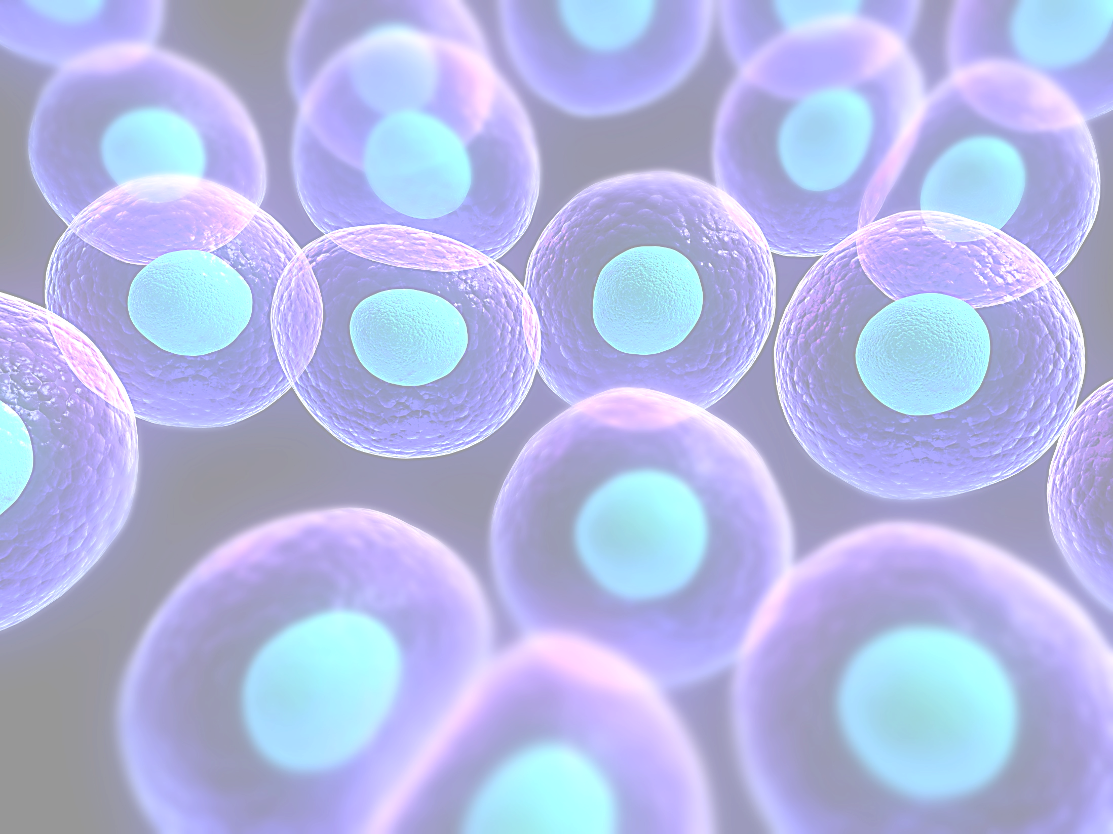
BIOLOGY
Is required for:
Veterinary Medicine - UCD
Elective Biology in Home Ecc. - St Angela's
Genetics - UCC
Human Health & Disease - TCD
Is very useful for:
P.E. teaching with Biology - DCU

Slide 20

PHYSICS
Is required for:
Theoretical Physics - TCD
Is very useful for:
Anyone considering courses in Engineering or Electronics.

Slide 21
Physical Education – New subject
Physical Education
Continued
Topics covered:
Learning and improving skill and techniques.
Physical and psychological demands of performance.
Structures, strategies, roles and conventions.
Promoting physical activity.
Ethics and fair play.
Physical activity and inclusion.
Technology, media and sport.
Assessment components:
Physical activity project – 20%
Performance assessment – 30%
Written examination – 50%
Students who enjoy physical sports and Biology in particular should excel in this subject.

Slide 22
LCPE – Assessment Criteria
There are three assessment components in Leaving Certificate Physical Education: A physical activity project, performance assessment and written examination.
Assessment component Weighting Level
Physical activity project 20% Higher and Ordinary
Performance assessment 30% Common level
Written examination 50% Higher and Ordinary

Slide 23
Physical Activity Project (PAP) – 20%
Can be taken at Higher & Ordinary level
Approximately 8-10 weeks will be spent completing this
Submitted in December of 6th Year
Must be completed in a different activity to the one selected for their performance assessment
Learner chooses the activity. It can be outside the activities of the current spec
May choose from one of the following roles – Coach/Choreographer or performer
It is completed in a digital format
You are assessed on 4 sections
Performance analysis
Identification of four performance goals
Evidence of ongoing training/practice and reflection
Concluding analysis

Slide 24
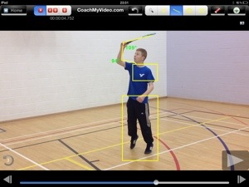
Performance Assessment – 30%
Common level
You choose one of the 3 selected areas of physical activities being studied
Required to demonstrate a range of skills, techniques and or compositional elements outlined in the Spec
The performance is captured digitally by the learner and in sessions that are designed to show the learner’s best personal performance in a variety of contexts
Clips will be captured digitally and collected over time during JAN –MAR in 6th year

Slide 25

Compulsory Subjects
Are there any subjects you need to do to gain entry to your dream college course or career.
Do you like this subject?

Slide 26

Third Language:
UCC
NUI Galway
UCD
Maynooth University Royal College of Surgeons
All require a pass in a third language for most of their courses eg O6
For example:
European Studies
Languages & Marketing
Hotel Management
Languages & International
Tourism
Other colleges require it for certain courses with a large language component.

Slide 27

Third Language:
Entry to the Cadetships in the Defence Forces requires a third Language.
NCAD require a third language or Art.
Many science & engineering courses include for example, Technical French or German, from scratch .

Slide 28
Third Language:
NO third language is required for:
Trinity College
University of Limerick
D.C.U.
Institutes of Technology
Unless it is a specific course requirement. A pass in Irish will suffice.
1.
UCC (19 courses not needing a third language)
NUIG (21 courses not needing a third language)
UCD (18 courses not needing a third language)
Maynooth Uni (17 courses not needing a third language)
2.

Slide 29

Does future college require a third language for entry.
Third Language:

Slide 30





Click any of the logos to link to the Qualifax Subjects Requirement Page here you can find all course subject requirements

Slide 31

Traditional
Leaving Cert Subjects

Slide 32
Modern Languages Group
French, German, Spanish
Continued
Having a modern language gives you greater scope when seeking employment after studying in a Third level College.
NUI Colleges (eg UCD, Maynooth Univ. UCG, UCC require a pass in a foreign language for many of their courses.
Students may choose more than one modern language to study..ie. They may pick up a new one in 5th year but in order to do so the student should have a flair for languages and work exceptionally hard in this subject area.

Slide 33


FRENCH
PRECONDITIONS | Junior Cert French Minimum Grade C in Higher Junior Cert to take Higher Level Leaving Cert
MARKING NOTES | Oral: 25% of total mark (H). Aural: 20 % (H)
NOTES ON COURSE | Higher & Ordinary levels have similar course content. Oral and written skills are of particular importance at higher level.
CAREER POSSIBILITIES | Teaching, translation, interpreting, journalism, media the I.T. sector .
USEFUL INFORMATION | 275 million people speak French across the world. It is the second most taught language in the world after English. French is spoken on all five continents of the world. France has the second biggest economy of the EU and is a world language. It is the official language of 29 countries.

Slide 34


GERMAN
PRECONDITIONS | Junior Cert German Minimum Grade C in Higher Junior Cert to take Higher Level Leaving Cert.
MARKING NOTES | Oral: 25% at Higher Level. Aural 25% Oral: 20% at Ordinary Level. Aural 25%
NOTES ON COURSE | Course contains 3 very structured sections.
CAREER POSSIBILITIES | Business, engineering, the IT industry, teaching, translation, interpreting.
USEFUL INFORMATION | Germany is currently the best performing economy in Europe.

Slide 35


SPANISH
PRECONDITIONS | Junior Cert Spanish
MARKING NOTES | Oral: 25% at Higher Level. Aural 20%
 | Oral: 20% at Ordinary Level. Aural 25%
NOTES ON COURSE | The standard of Spanish expected at Higher Level is high.
CAREER POSSIBILITIES | The IT industry, teaching business, translation, the hospitality industry, tourism.
USEFUL INFORMATION | Spanish is the second most used language on the Internet. It is the official language in 27 countries.

Slide 36
The Sciences
Overview
Continued
Biology is by far the most popular of the all the science subjects followed by Chemistry and Physics.
Although not mandatory for all courses at Third Level, it is nonetheless recommended that students choose a Science subject PROVIDED they have a general interest in this area.
If not, there is no need to choose a Science subject.
Many areas of study do not require a science subject at all eg, Primary school teaching, Accountancy, Business, Law, Computer Science, some Engineering courses etc.

Slide 37

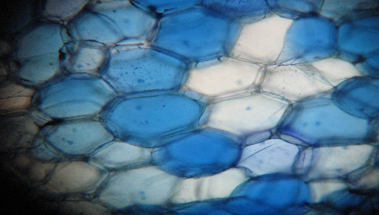
BIOLOGY:
REQUIREMENTS | An interest in living things, the environment & fieldwork.
COURSE CONTENT | 22 mandatory practicals The Study of Life The Cell The organism Extensive vocabulary to familiarise.
CAREER POSSIBILITIES | Medicine, Veterinary, Dentistry, Nursing, Agriculture, Biotechnology, Botany, Ecology, Environmental Science, Genetics, Marine Science, Microbiology, Zoology, Psychologist, Astronomer, Teacher, Researcher.
USEFUL INFORMATION | Recording information & drawing diagrams is important. Biology isn’t the ‘easiest’ of the Sciences. There is a lot of knowledge to learn and process.

Slide 38


CHEMISTRY:
CHEMISTRY | Good aptitude for maths. Reasonable problem-solving skills.
COURSE CONTENT | History of famous scientists & discoveries. High detail on Periodic Table & Atom. Interesting & accurate chemical analysis. Organic Chemistry – chemicals in everyday life. Water Analysis .
CAREER POSSIBILITIES | Pharmacy, Ag Science, Medicine, Engineering, General Science, Biotechnology.
USEFUL INFORMATION | The leaving cert exam is three hours in duration. Each candidate must answer at least two questions from Section A (experimental section) and a maximum of six questions from Section B. There are eleven questions in total on the exam paper, each carrying fifty marks.

Slide 39

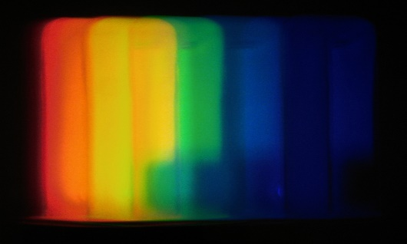
PHYSICS:
REQUIREMENTS | Good aptitude for maths. Problem-solving skills.
COURSE CONTENT | 24 mandatory experiments. Light/Sound, Mechanics, Temperature/ Heat, Electricity, Magnetism, Radioactivity, Particle Physics or Applied Electricity for Honours candidates.
CAREER POSSIBILITIES | Electrician, Optician, Doctor, Dentist, Engineer, Computer Technician, Programmer.
USEFUL INFORMATION | Junior Cert honours maths students do well in Leaving Cert physics.

Slide 40
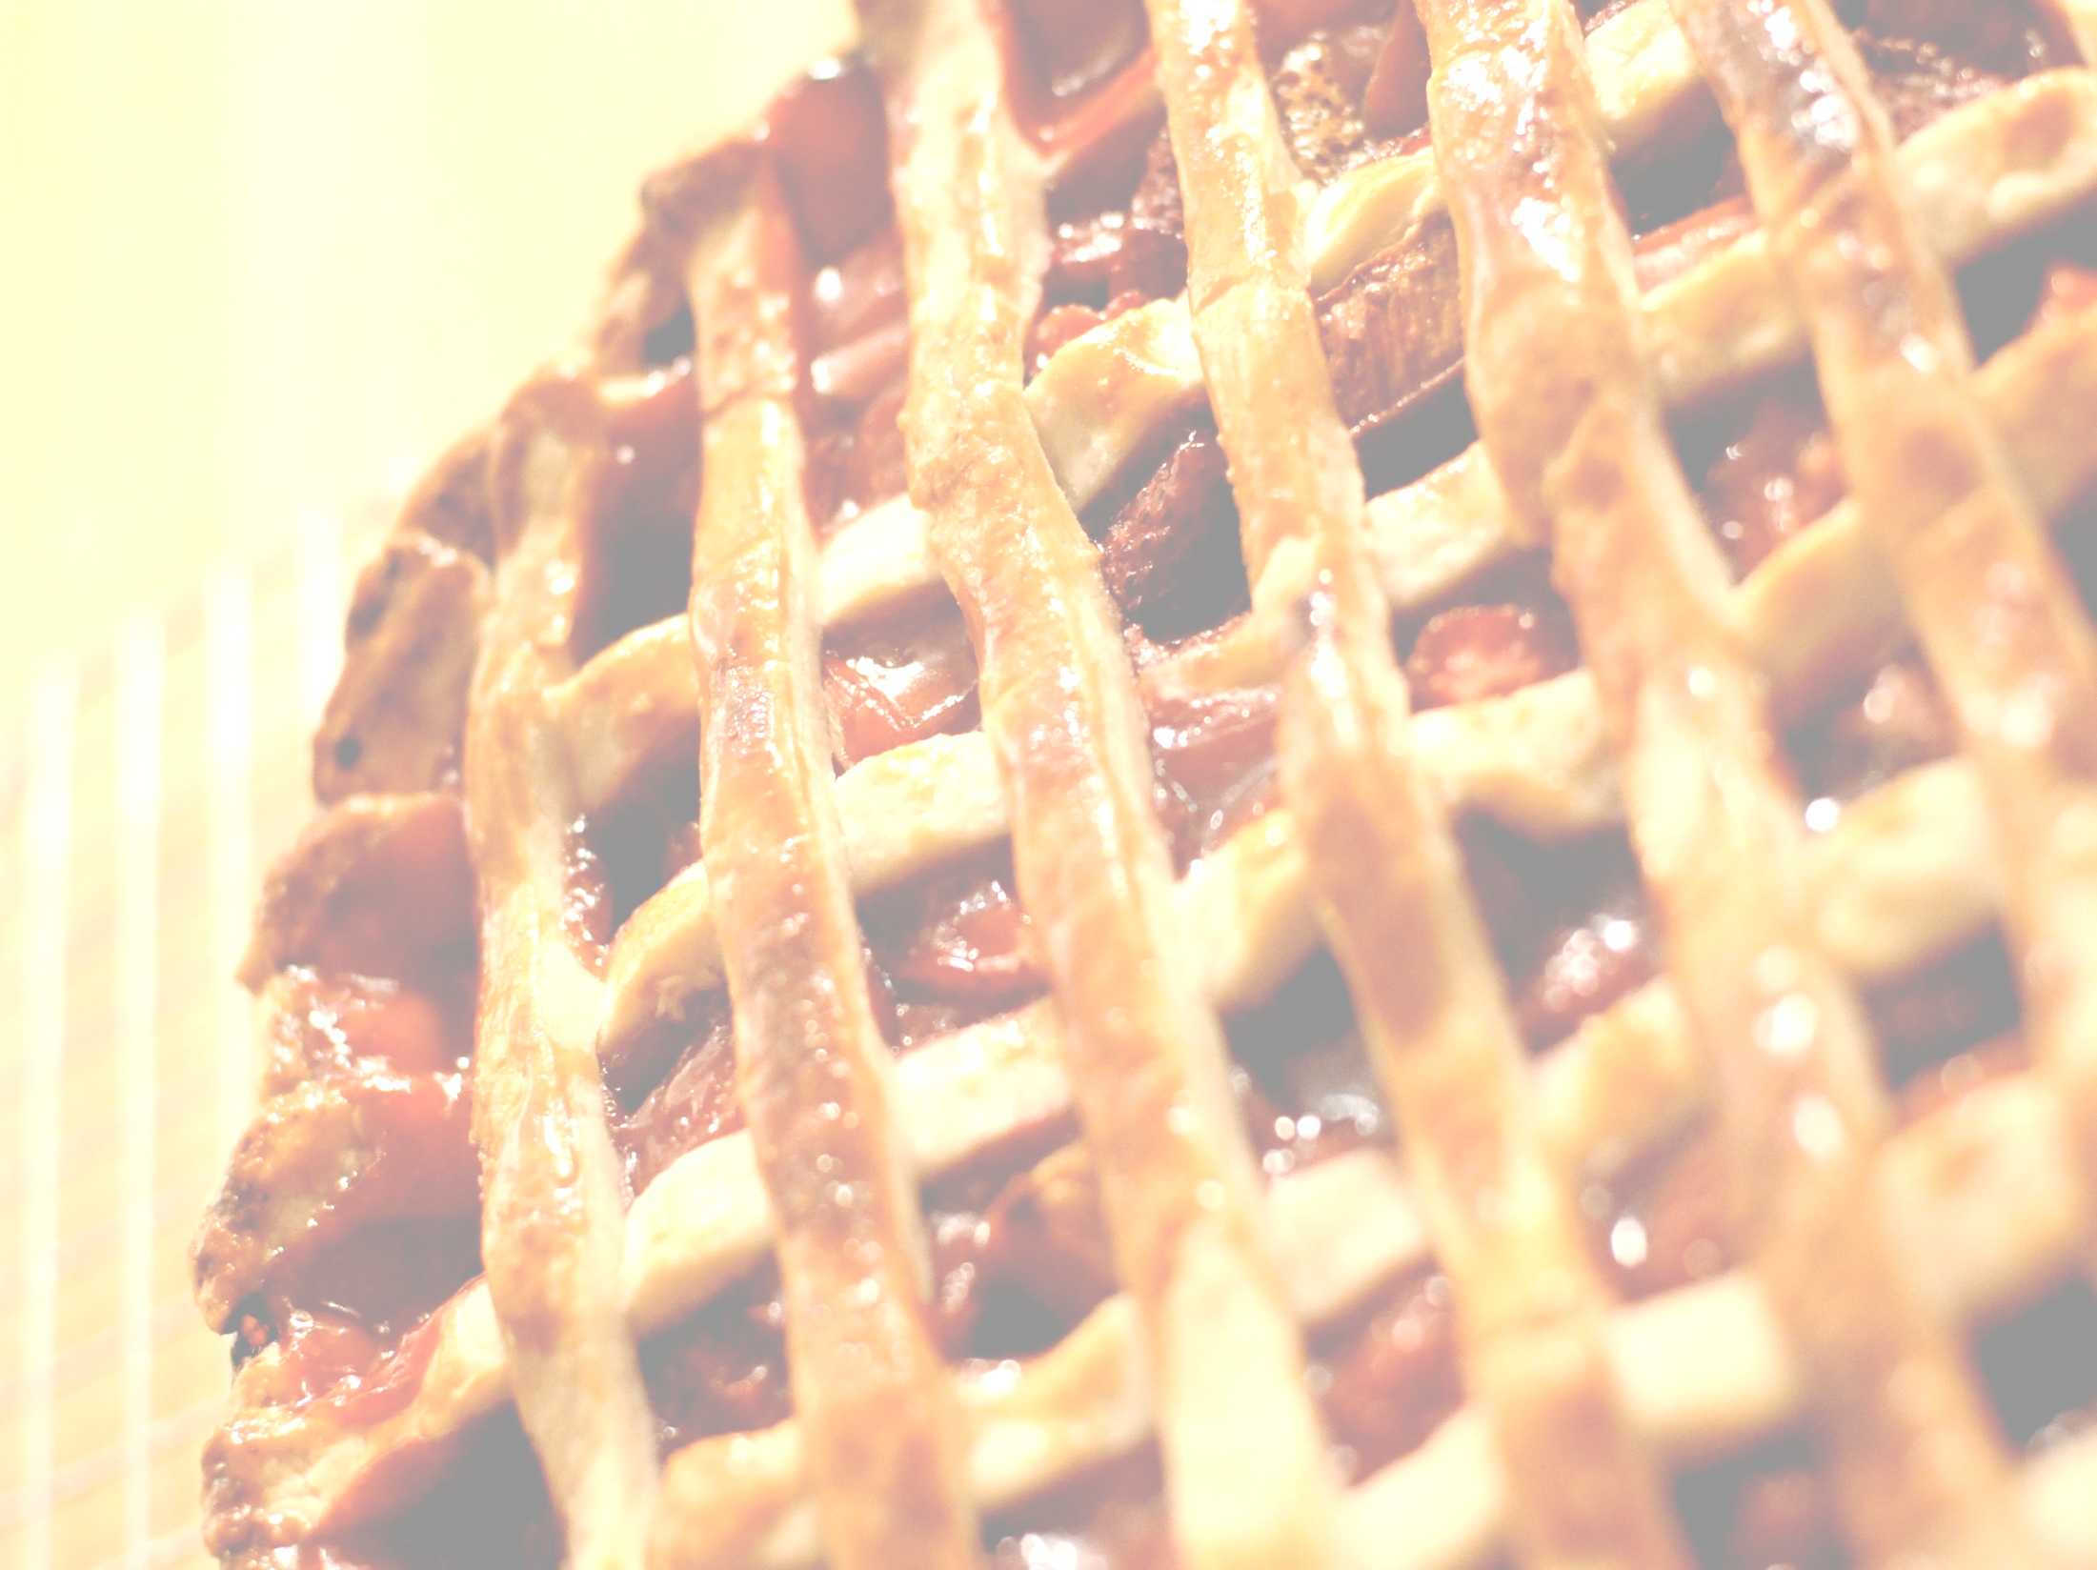
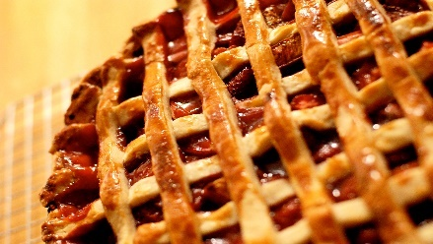
HOME ECONOMICS (SOCIAL & SCIENTIFIC):
REQUIREMENTS | Completion of the Junior Cert an advantage.
COURSE CONTENT | A. Food Studies 45% B. Resource Management & Consumer Studies 25% C. Social Studies 10% D. Elective 20%. Elective choice: 1. Social Studies, 2. Textile, Fashion & Design, 3. Home Design & Management.
CAREER POSSIBILITIES | Food industry, tourism, clothing & design, health & social services, interior design & education.
USEFUL INFORMATION | Some material is designated Higher Level only. There is no practical cookery exam for the Leaving Cert. There is a significant amount of theory to be covered requiring commitment & concentration.

Slide 41

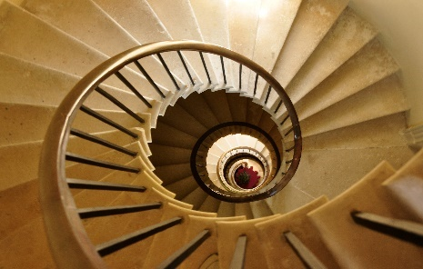
APPLIED MATHS:
REQUIREMENTS | Enjoyment of mathematics.
COURSE CONTENT | Constant Acceleration, Relative Velocity, Projectiles, Work Energy & Power, Conservation of Momentum, Circular Motion, Simple Harmonic Motion, Rotation around a Rigid Axis, Differential Equations, Newton's Law & Connected Particles. Written examination - 80% Modelling project 20%
CAREER POSSIBILITIES | Engineering, Physics, Construction, Architecture.
USEFUL INFORMATION | If you are considering Physics and higher level Maths then consider taking Applied Maths. Chemistry also works well.

Slide 42
Applied Maths continued
The Applied Mathematics course at Leaving Certificate would be called 'Theoretical Mechanics' or 'Mathematical Physics' in third level education and it is one of many branches of the more general field of Applied Mathematics.
The course essentially covers the mathematics behind the behaviour of objects when placed in various situations, such as being thrown as projectiles, bounced off walls or other objects, immersed in fluids, or swung around on a rope.
There are 10 questions on the exam paper, each covering one of these topics in detail.

Slide 43

Bonus Points for Higher Level Mathematics…
Any student who achieves a grade a H6 or higher will earn an extra 25 points in their Leaving Certificate.
Foundation Level Maths is recognised by many colleges for matriculation purposes but not for points. A small number of courses allow points for Foundation Level Maths.

Slide 44


BUSINESS:
REQUIREMENTS | Junior Cert Business Studies an advantage. Keep up to date with current affairs and the news.
COURSE CONTENT | People in Business, Business Conflicts & Resolution. Enterprise, Management of Business. The Irish Business System, E.U. & International Business.
CAREER POSSIBILITIES | Banking, Insurance, Administration, Marketing, Business Management, Human Resource Management.
USEFUL INFORMATION | Useful to anybody contemplating starting his or her own business in the future. Very practical and interesting to someone of a business mind.

Slide 45


ACCOUNTING:
REQUIREMENTS | Junior Cert Business an advantage.
COURSE CONTENT | FINANCIAL ACCOUNTING: Accounting Records, Sole Traders, Company Accounting, Specialised Accounts, Incomplete Records Cash Flow Statements. MANAGEMENT ACCOUNTING: Marginal Costing, Product Costing, Budgeting.
CAREER POSSIBILITIES | Many top executives in Business have an accountancy background. Can be a passport to working abroad.
USEFUL INFORMATION | Does not require exceptional Mathematical skills but need to be conscientious & thorough.

Slide 46


ECONOMICS
REQUIREMENTS | Being interested in the economy.
COURSE CONTENT | Micro-Economics – dealing with individual business units and structures. Macro-Economics – dealing with the economy regarding Inflation & Government Policy, Employment & Job prospects, Rate of Inflation & the European Central Bank, Population & the study of some famous Economists. Research project in first term of 6th year worth 20%.
CAREER POSSIBILITIES | Banking, Insurance, Finance, General Business, Marketing.
USEFUL INFORMATION | Not having done Junior Cert Business is NOT a disadvantage. Course is short compared to Leaving Cert Business. Outside reading required for Higher Level. Strong aptitude for maths essential for this subject.

Slide 47
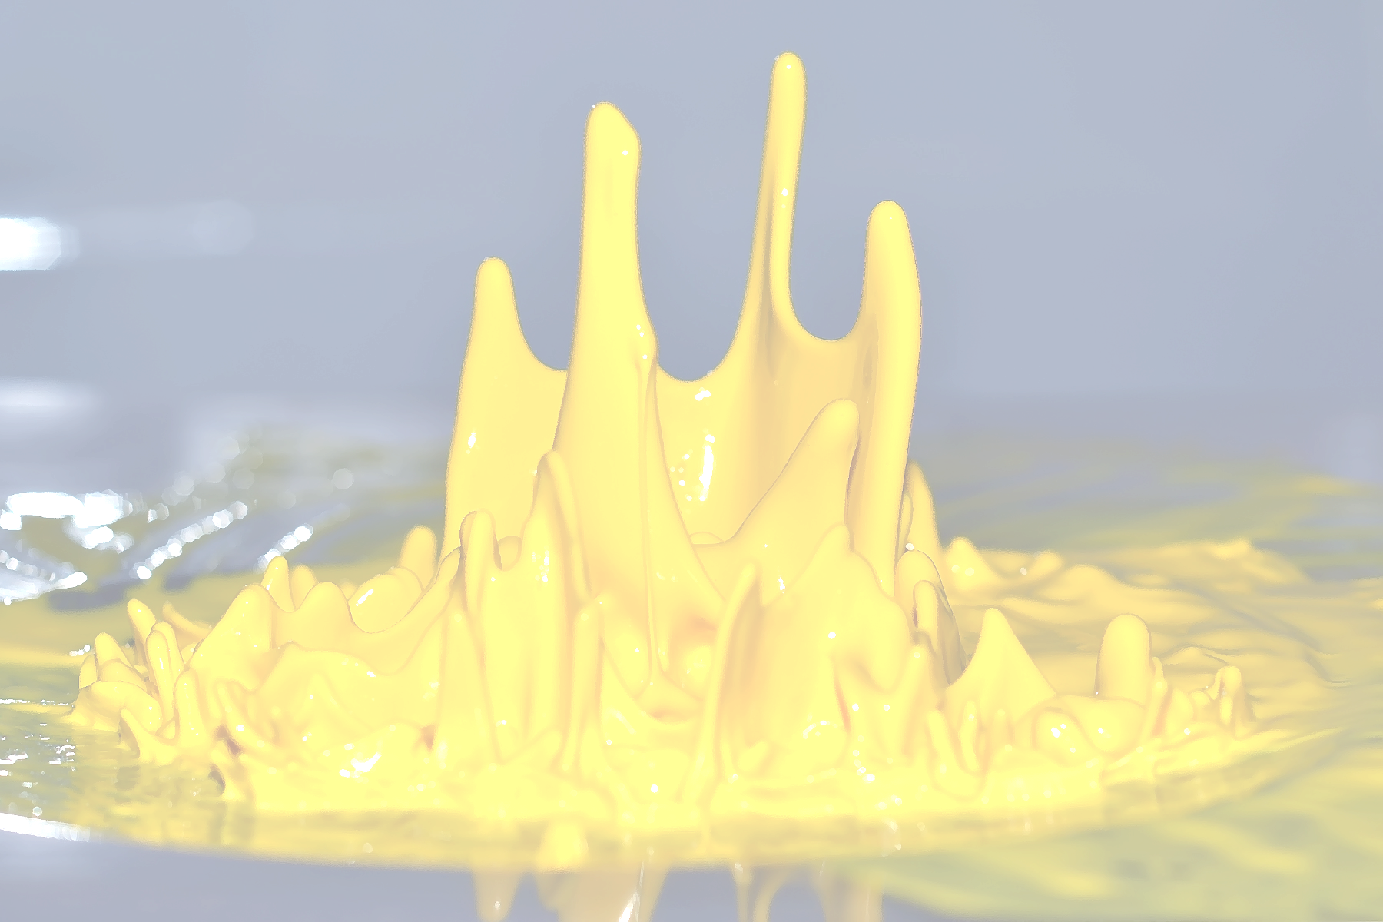
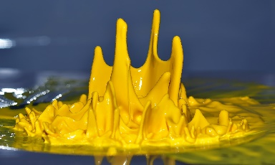
ART, CRAFT & DESIGN:
REQUIREMENTS | An interest in Art & Art History
COURSE CONTENT | Practical lessons, developing skills in observational drawing, painting & craftwork. At least one visit to galleries/museums. • Imaginative Composition or Still Life – 25% • Design or Craftwork – 25% • Figure/Life Drawing – 13% • Art History and Appreciation – exam & written assignments – 37%
CAREER POSSIBILITIES | Animation, art historian, art teaching, art therapist, archaeology, architecture, computer design, industrial design, fashion/costume design, craftwork, curator, graphic design (Visual Communications), interior design, illustration, photography........
USEFUL INFORMATION | Examinations may be taken in Higher or Ordinary Level in each of the above areas. A portfolio of artwork may be required for entry into some college/university courses. Students should aim to have some of their portfolio completed in fifth year.

Slide 48

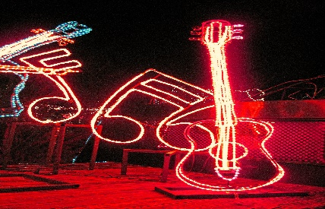
MUSIC:
REQUIREMENTS | Being good at performance, desirable.
COURSE CONTENT | Listening (25%) Composing (25%) Performing (25%) (the voice is also an instrument!) Performance or Music Technology 25%
CAREER POSSIBILITIES | Primary Teaching, Second Level Teaching, Sound Technician, any area of the Music Business, performing or production.

Slide 49
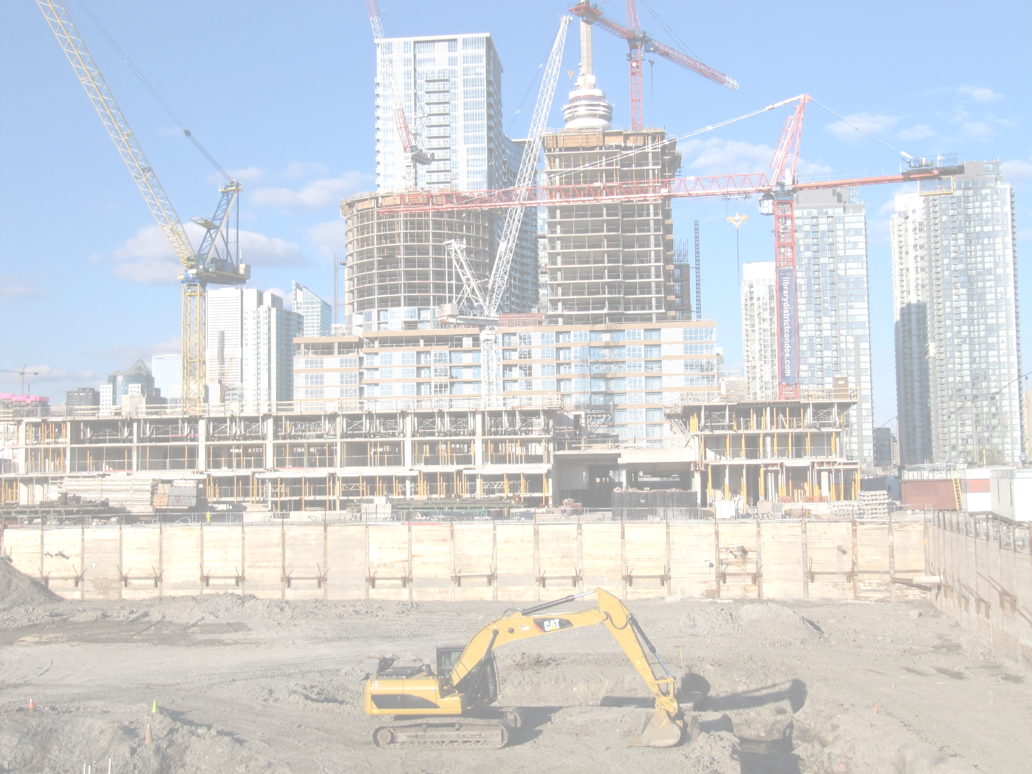
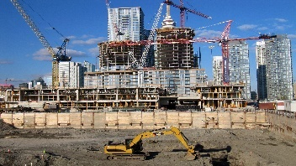
CONSTRUCTION STUDIES:
REQUIREMENTS | Interest in buildings & the built environment. Aptitude for design & practical work.
COURSE CONTENT | Woodwork practical exam 25%, (4hours). Project 25%: Items of furniture. Using at least 2: joinery, woodturning, veneering/ marquetry, laminating or wood carving. Theory paper 50%. Topics: Irelands historic buildings, Rural & urban planning; Passive house design; Insulation; Air tightness; Zoned heating systems; Geothermal heating; Carbon neutral buildings; Water conservation; Renewable energies.
CAREER POSSIBILITIES | Carpentry, electrician, electrical engineer, engineer, plumbing.
USEFUL INFORMATION | Not having done Junior Cert Woodwork is NOT a disadvantage.

Slide 50


DESIGN & COMMUNICATION GRAPHICS
REQUIREMENTS | Junior Cert Technical Graphics Interest in construction or engineering. Good at maths & problem solving. Interest in freehand sketching, Computer Graphics & CAD. Neat and has good attention to detail.
COURSE CONTENT | 3 hour written exam. Research & Design Project in 6th Year. 40% of marks. Drawings Portfolio to include: Plane & Solid Geometry, Building Applications, Engineering Applications and a Compulsory Computer Aided Design Project.
CAREER POSSIBILITIES | Engineering, construction, industrial design, interior design & Architecture.
USEFUL INFORMATION | Studying of DCG is a distinct advantage for all apprenticeships.

Slide 51
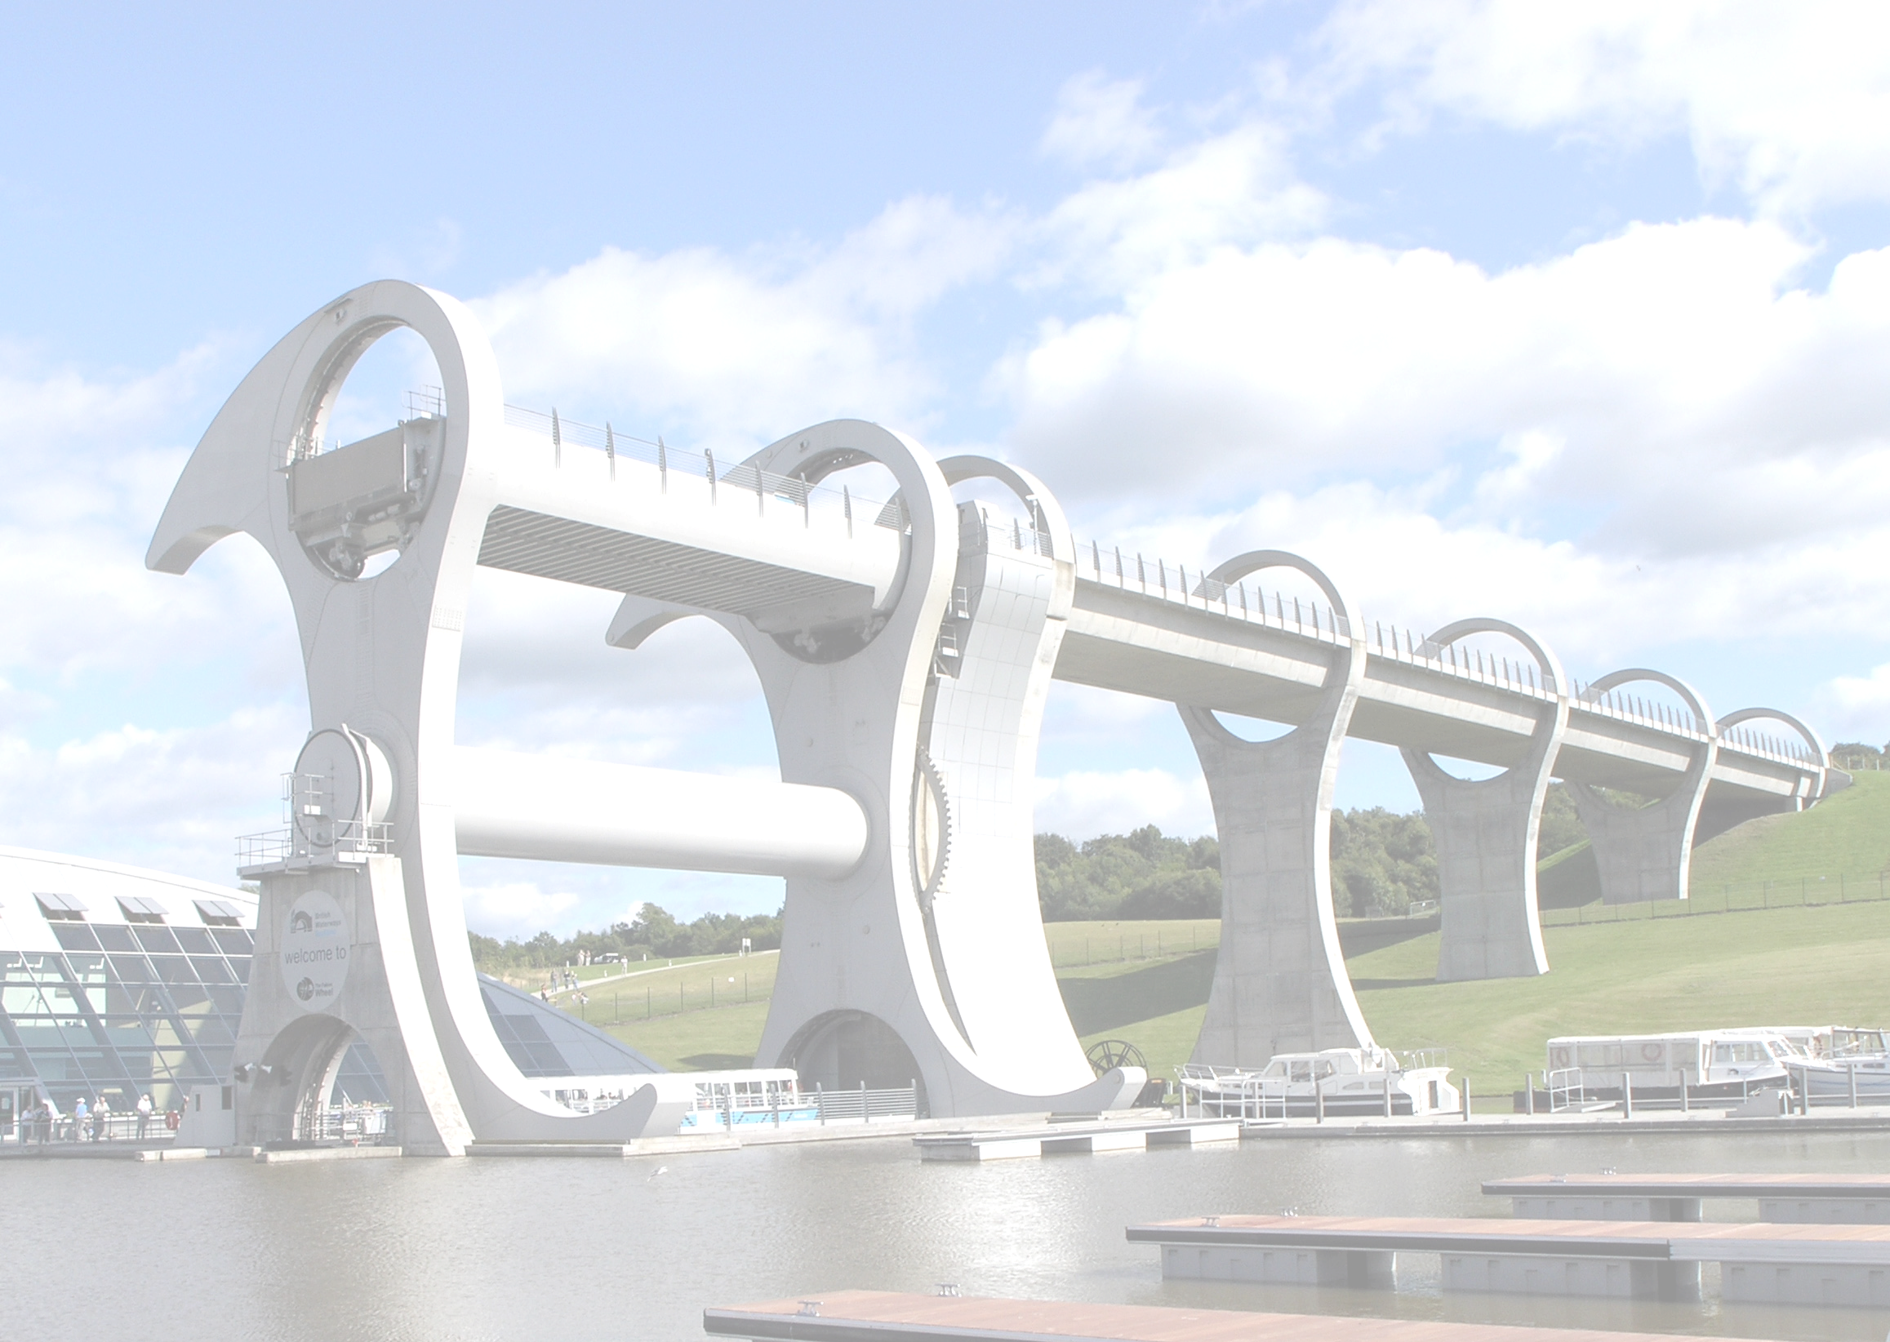
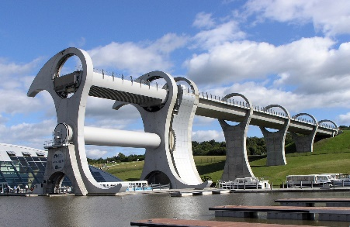
ENGINEERING:
REQUIREMENTS | Technical Junior Certificate subject essential – Carries on from Junior Cert Metal Work
COURSE CONTENT | Expected to design for themselves. Twelve week design & make project for 25%. A six hour practical exam for 25%. A three hour theory exam for 50%. Practical: Drilling; Milling, Lathes, Band Saws, Various Welding procedures and computer aided machinery. Theory: Metals, plastics, materials testing, welding machining techniques, alloy technology, mechanisms & electronics.
CAREER POSSIBILITIES | Mechanic, panel beater, sheet metal worker/ fabricator, welder, fitter, turner, plumber,, steel fixer, engineering teacher all types of engineering, computer aided manufacture, architecture, designer

Slide 52


GEOGRAPHY:
COURSE CONTENT | 3 Core Units: Patterns & Processes in the Physical Environment Regional Geography. Different regions of the world. 3.Geographical Investigation - fieldwork project 20% Elective Units: Patterns & Processes in Economic Activities or Human Environment.
CAREER POSSIBILITIES | Tourism, Transport, Travel, Environmental Science, Politics, Town Planning, Surveying, Weather Forecasting, Map-making and Environmental Assessment.
USEFUL INFORMATION | Higher level elective options only Global Interdependence, Geo-ecology, Culture and Identity or Atmosphere-ocean environment.

Slide 53
Humanities Group
Politics and Society
Continued
Subject was examined for the first time in June 2018.
Politics and society will suit any student who is interested in areas such as human rights, equality, diversity, sustainable development power and democratic decision-making.
Politics and Society is a useful subject for those wishing to study politics or sociology or other courses such as law, anthropology, philosophy, development and cultural innovation studies.
The subject will be assessed through a written exam (80%) of marks and will also involve a citizenship project undertaken by individual students which will attract 20% of the final marks.

Slide 54
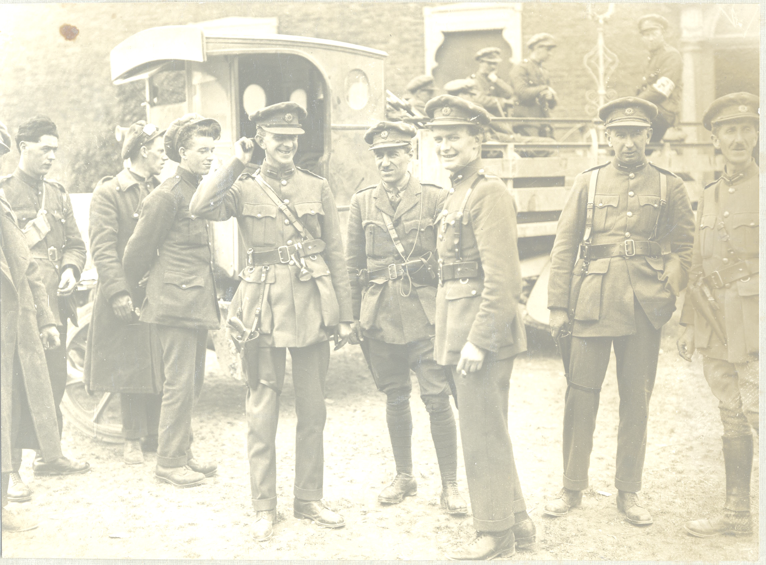
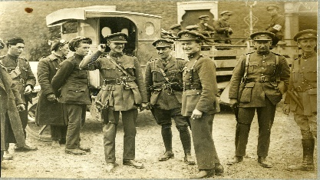
HISTORY:
COURSE CONTENT | 5 topics, each worth 20%. 2 Irish history topics & 2 world events topics plus 1 Research Study Report. Learn to support arguments with relevant evidence. Learn about people, countries and cultures. Learn how to separate fact from fiction. Insight into your own identity and tradition.
CAREER POSSIBILITIES | Arts, journalism, web-based research, museums, tourism, local and national government, broadcasting companies, banking, teaching.
USEFUL INFORMATION | Studying History sharpens communication, writing & research skills. History develops an ability to think independently. History gives you a better understanding of the world we live in.

Slide 55

Subject Choice
List, in order of preference, your desired Leaving Cert subjects for next year (excluding Maths, English, Irish).

Slide 56
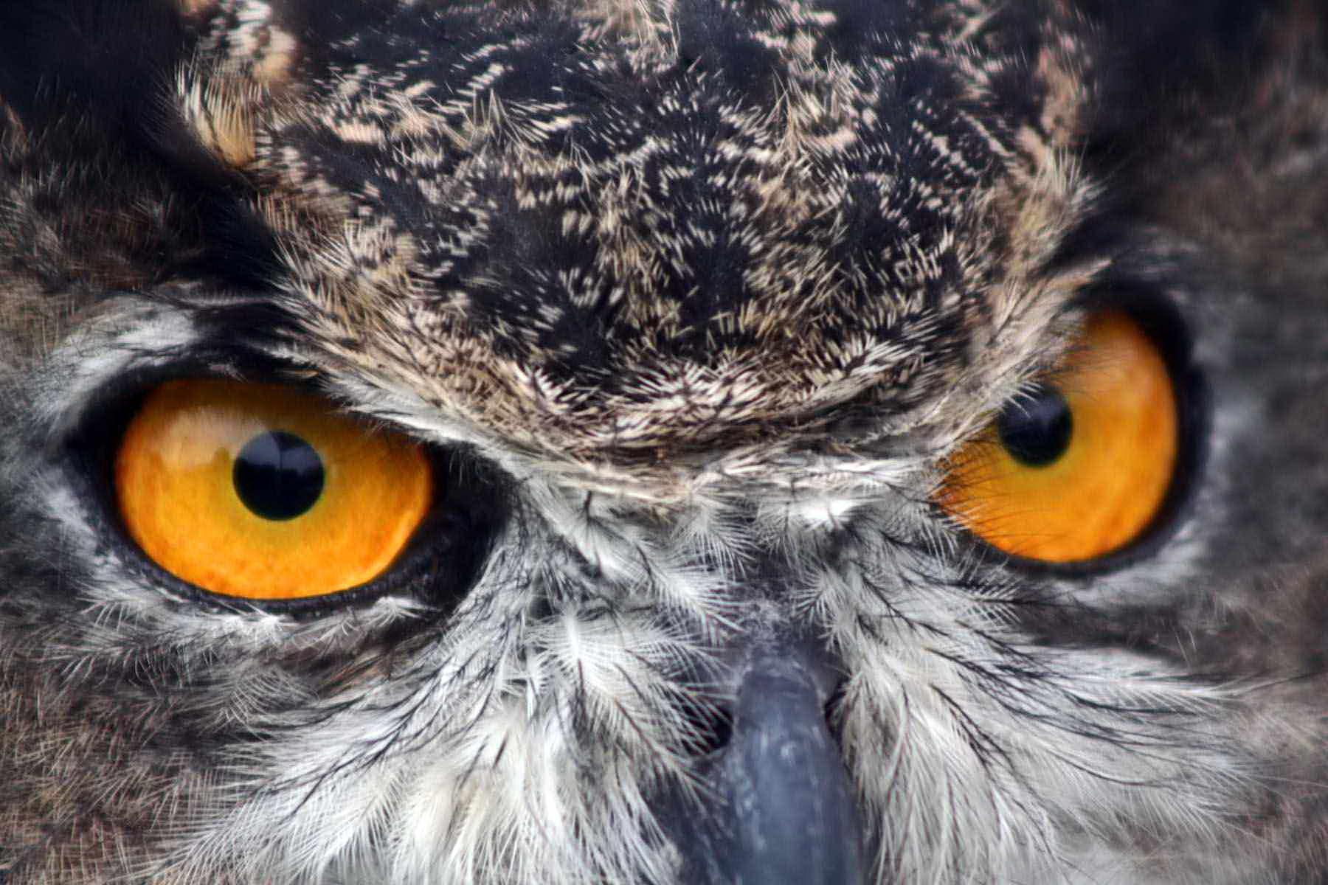
This information is correct in Jan 2023 but is subject to change - check with the course provider or your Guidance Counsellor

Slide 57
Questions????
Please address any queries you may have to:
ffarrell@portmarnockcommunityschool.ie
and/or
bcoggins@portmarnockcommunityschool.ie
Or call the Office on 01-8038056.

