Slide 1
FIRST YEAR PARENTS AND GUARDIANS 2025/26
Welcome!

Slide 2

TEAM

Slide 3
FIRST YEAR TEAM
PRINCIPAL – Ms Tobin
DEPUTY PRINCIPALs- Ms Moran
Mr Clarke - First Years
Ms Molamphy
YEAR HEAD – Ms Coggins
Tutors
AEN Coordinator: Ms C Cronin
Chaplain: Ms C Clarke
Guidance: Ms Coggins
JCT Coordinator: Mr Naughton

Slide 4

SUPPORTS

Slide 5
Guidance Counsellor’s Role
To assist each student in their:
Personal development
To encourage each student in following an educational path which is appropriate for them.
To support students who may be experiencing difficulties in their lives, at home or at school.
To facilitate students in choosing and embarking on a career path which will be personally rewarding and will reflect their individual talents and values.
To help students at times of transition.

Slide 6
Guidance Counselling Supports
6th Class Transition Programme
Transition Support Follow Up - Classroom based workshop
Check and Connect Meetings
1:1 Guidance Appointments

Slide 7
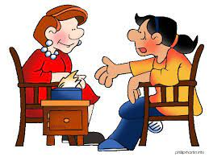
Guidance Appointments
Guidance appointments cover three areas:
-Vocational
-Educational
-Personal

Slide 8
Guidance Counselling Appointments
Can be made by students themselves by email or in person
-Parents
-Yearhead
-Principal, Deputy Principals

Slide 9
Supports
Subject Teacher
Tutor
Year Head
Deputy Principal/ SNA
Guidance Counsellor
Designated Liaison Person – Principal Ms Tobin
Deputy Designated Liaison Person – Deputy Principal Mr Clarke

Slide 10

COMMUNICATION

Slide 11
COMMUNICATION PROTOCOLS
CLASSROOM – TEACHER –teachers may contact you regarding how the student is doing, behaviour, homework concerns etc
PASTORAL – TUTOR- tutors from time to time may check with parents regarding your son/daughter
YEAR HEAD - Year Head’s contact parents regarding several issues- pastoral, concerns, behaviour, incidences
DEPUTY PRINCIPAL/ PRINCIPAL -if any issue has arisen that requires the attention of Senior Management, the Deputy Principal or Principal will be in touch or arrange a meeting.
If you as the parent/guardian want to make an appointment, speak with a teacher, senior management or have any issues of concerns, please contact the Office at (01)8038056 or email admin@portmarnockcommunityschool.ie
The Office will forward your email or message to the parties concerned.
Allow time for teachers to get back to you

Slide 12
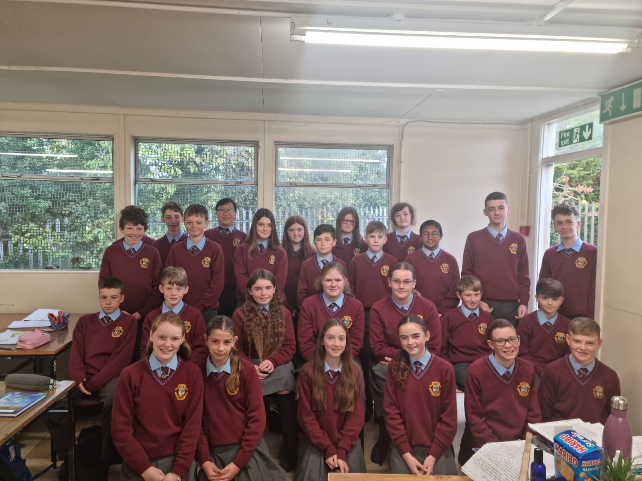

UNIFORM

Slide 13
ROLES AND RESPONSIBILITIES- UNIFORM
SCHOOL JUMPER, SHIRT, TIE AND TROUSERS
SCHOOL JACKET- TO BE WORN AT ALL TIMES, INCLUDING ON PE DAYS
SCHOOL SHOES- LEATHER OR LEATHER LOOK SHOES
STUDENTS WEAR PE GEAR IN ON PE DAYS ONLY, SCHOOL JACKET MUST BE WORN ON THESE DAYS.
MAKEUP, FALSE TAN, FACE PIERCINGS, ANY FORM OF BODY PIERCING, ANY FORM OF FALSE NAIL, NAIL VARNISH- NOT PERMITTED
HAIR A NATURAL COLOUR
CLEAN SHAVEN, SINGLE STUD EARRINGS, IN BOTH EARS OR A PAIR OF SLEEPER EARRINGS. IN BOTH EARS.

Slide 14
My appearance:
I will have my full uniform on every day. Plain black leather/leather look shoes. Put your name on everything.
I will wear my school jacket at all times, even on PE days. No non-uniform jackets will be worn. Any non-uniform jackets will be confiscated.
My hair will be a natural colour. Boys will be clean shaven. One pair of plain stud earrings. No nose or body piercings. No make-up. No false eyelashes, false nails, tan or nail varnish.
PE gear can be worn on PE days only.
I will wear my uniform on school trips, to represent my school with pride.

Slide 15
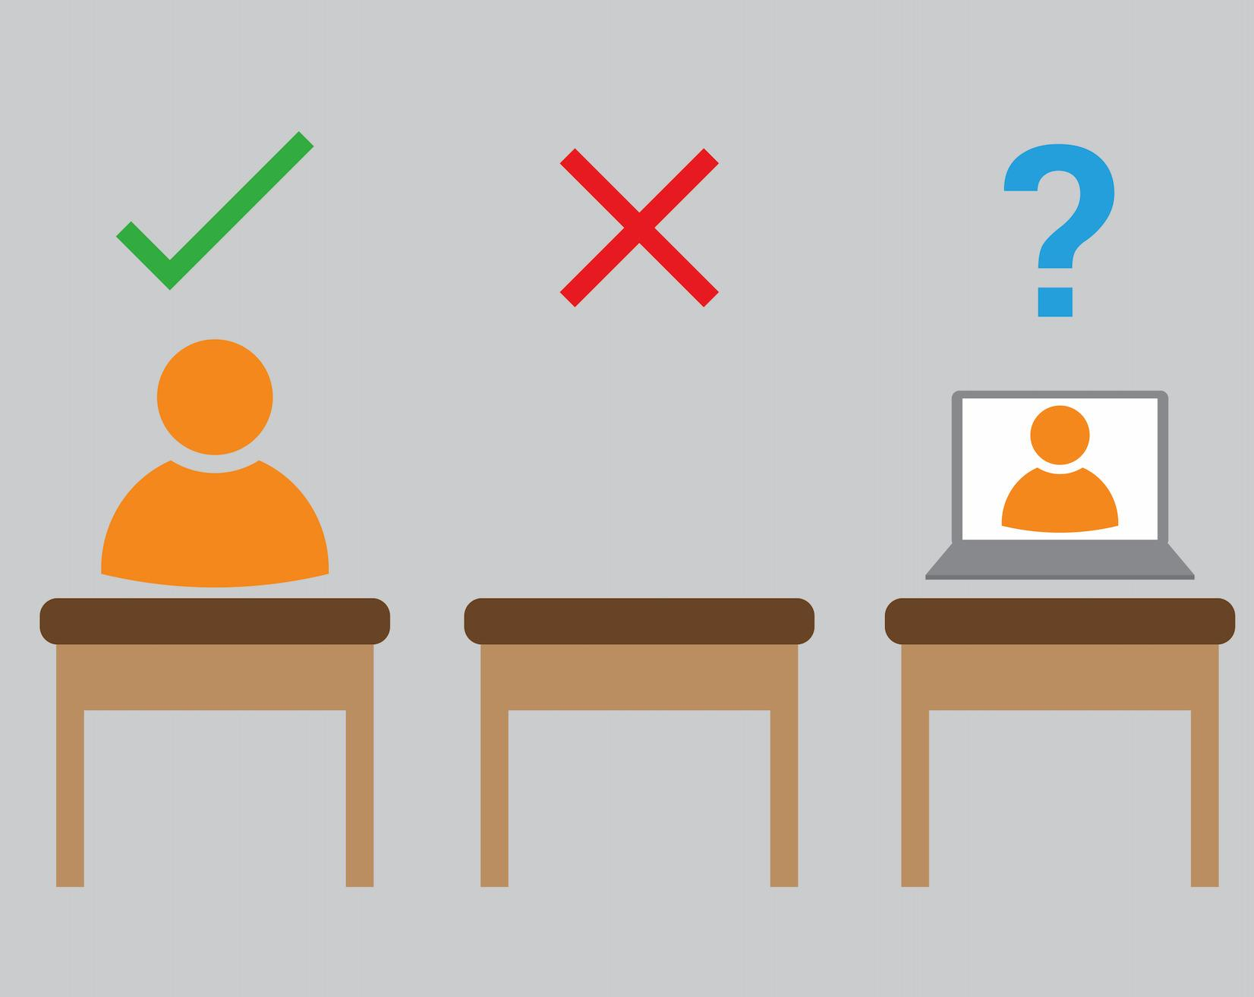
ATTENDANCE

Slide 16
EDUCATION AND WELFARE ACT
PROVIDE A NOTE OF EXPLANATION FOR ABSENCE ON TYRO & IN JOURNAL
UNEXPLAINED ABSENCES
PROCEDURE FOR GOING HOME UNWELL
APPOINTMENTS- email the main office, note in journal, same procedure for leaving
STUDENTS ARE NOT ALLOWED TO LEAVE THE SCHOOL WITHOUT PERMISSION
STUDENTS SHOULD NOT TEXT HOME TO REQUEST TO LEAVE
ANY STUDENT, NOT able to have lunch at home, MUST REMAIN ONSITE ALL DAY- INCLUDING LUNCH TIME AND BREAK TIME
FIRST, SECOND AND THIRD YEAR STUDENTS ARE NOT PERMITTED TO DUNNES STORES, SPAR OR THE PSLC

Slide 17

Tyro

Slide 18
Tyro
Online system that records attendance
Notes for absences
Parental access to view their son/daughter’s attendance and behaviour
Also provide parents with access to view term reports
If your son/daughter is late P1/P7 you will receive a message informing you
Access to pay for lockers, trips, exams, etc…
Notices by mail - ensure notifications turned on
If you have not gained access, contact the office

Slide 19

MOBILE PHONES
Students when using the bathrooms will leave their phone on the teachers desk.
Phones should be turned off when in school
If a student is using their phone without permission, be it in the classroom, bathrooms, at lunch, break time or anywhere onsite, the phone will be confiscated and held securely for a period of 24hrs.
Parents/Guardians will be informed and will collect it the following day
Failure to hand over the phone will result in a suspension and the phone confiscated for a week.

Slide 20
How can our policy be supported in the home?
Encourage and teach good and safe behaviours online
Good patterns with phone use in the evenings
Cyberbullying and Bi Cinealta
Monitor Snapchat, WhatsApp groups
A lot of helpful information regarding “Examples of expected use” of phones- Journal page 31
Webwise

Slide 21
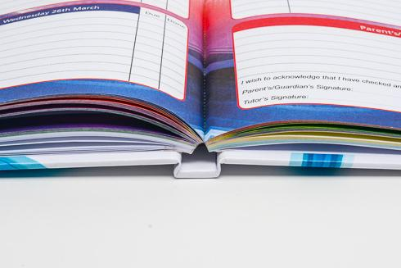
School journal and homework

Slide 22
Encourage good habits with regard to monitoring the journal
Students prepared and organised
Good homework habits
Routine
Study
Assessments
Behaviour for Learning
Respect

Slide 23
My classroom:
I will be ready for learning at the classroom door at 8.40 am and 1.55 pm. I will line up at the classroom door until the teacher arrives for each class (unless remaining in the class).
I will remain in my seat, prepare for my next class and behave while I am waiting for the teacher to arrive.
I will have all of the relevant books and materials for every class.
I will be punctual to every class on my timetable.
I will ensure that I follow all instructions given by my teacher.
I will ensure that I note all my homework into my school journal, before I leave the lesson.
I will be respectful when working with my teacher online.

Slide 24
I will ensure that I will be mindful of my behaviour to the teacher and other students, when I am on an online lesson.
I will be very respectful and kind when working in class, with another student(s).
I will have a note of explanation in my journal for any absences the next day.
I will ask the Principal, Deputy Principal or Year Head if I have to leave during the school day. If I feel sick I will not contact a parent/guardian myself but will go through the office.
If I have an appointment my parent/guardian will provide a note.
I must always sign out at the office if permission has been given to me; by a parent’s note, a teacher, Year Head or Deputy Principal; and a call has been made, by the school, to my parent/guardian informing them that I am leaving the school. If I do not follow these procedures, I may be liable to a suspension.

Slide 25

“How can I help my child succeed at secondary school?”

Slide 26
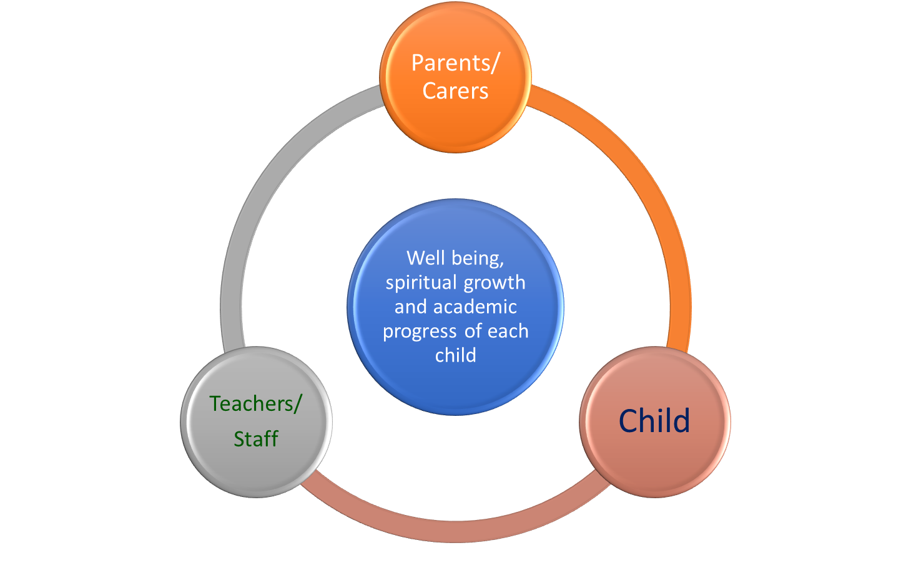

Continued partnership in education

Slide 27
Growth mindset in action
Reading regularly
Arriving to lessons well prepared
Maintaining excellent attendance
Home learning completed on time and to a high standard
Asking questions to improve understanding
Sharing ideas with others
Respond to teacher’s feedback in books and lessons
Never waste time talking in lessons
Find out how other people have achieved high marks
Reflect on success: What was it that made you succeed?
Studyclix

Slide 28
Junior Cycle Information
A guide to the new Junior Cycle Framework

Slide 29
Overview- what they are working towards
On completion of their three years in school, students will receive a Junior Cycle Profile of Achievement Certificate issued by the school.
  Subject exam results (to a maximum of 10 subjects).
  Classroom Based Assessment results each in these subjects.
  Other Areas of Learning statements.
  Wellbeing Reporting.
  Other Areas of Wellbeing statements.

Slide 30
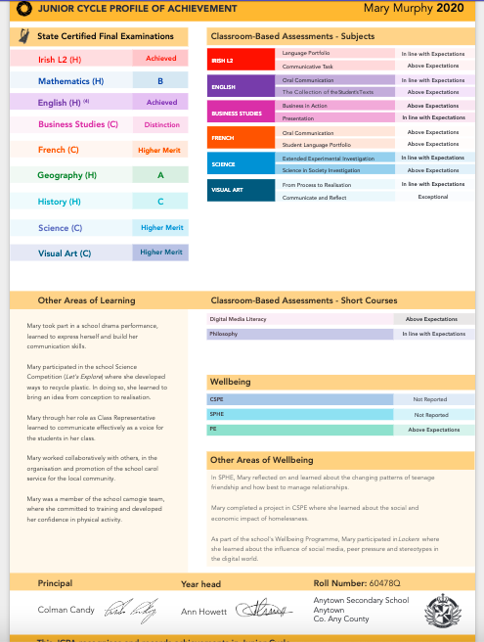
Junior Cycle Profile of Achievement Example

Slide 31
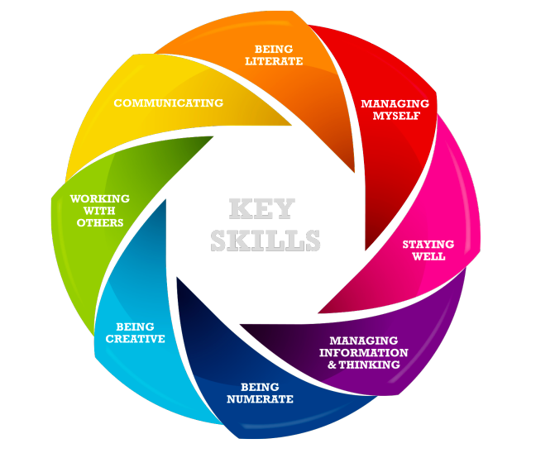
Key Skills - Main Focus
Being Literate
Managing Myself
Staying Well
Managing Information & Thinking
Being Numerate
Being Creative
Working with Others
Communicating

Slide 32
First Year
First Year is to lay the foundation of subject content and skills that students will be using in the next two years.
No results from First Year will appear or feed into the Junior Cycle Profile of Achievement (JCPA).
What students CAN be doing this year is involving themselves in as many activities as they can outside of the classroom. They CAN use these for their Other Areas of Learning (OALs), which does appear on their JCPA.

Slide 33
Other Areas of Learning
Students can include achievements outside of the classroom in this section. They MUST be school related.
There are pages in the school journal where students can record their involvement in school activities. It is important that they keep UPDATED lists throughout their three Junior Cycle years.
Examples of Other Areas of Learning would be Student Council, Green Schools, Choir, School Sports, Student of the Year Awards, Workshops, Student Wellbeing Committee, Debating, Gaeilge24 and the list goes on!

Slide 34
Classroom Based Assessments
Classroom Based Assessments (CBAs) are typically done over two years, Second Year (CBA1) and Third Year (CBA2) in class time.
Subject teachers will let students know the details of their CBAs
They are assessed within the school by class teachers and DO NOT form any part of the State Examinations.
The results of these are descriptors, which will be printed on the student’s Junior Cycle Profile of Achievement.
Students will have a lot of CBAs to complete throughout second year. The main thing is to stay focused in class time and listen to their teacher’s feedback and instructions.

Slide 35
Classroom Based Assessment Descriptors
CBAs are assessed according to the Features of Quality set for each subject by the NCCA. These are used nationwide by every teacher in every school.
Exceptional
Above Expectations
In Line With Expectations
Yet to Meet Expectations
MOST students are expected to achieve In Line with Expectations as CBAs are a snapshot of where that student is expected to be in terms of their learning at that point in time. MOST should and will fall into the In Line with Expectations range.

Slide 36
Third Year: Junior Cycle Exams
Students sit exams in their subjects in June of their Third Year (except for Visual Arts).
All papers are Common Level, except for English, Gaeilge and Maths. These subjects have a Higher and Ordinary level paper. All exams have ONE paper only.
Some subjects have practical components that are worth a percentage towards the final mark. These subject teachers will explain this information when necessary to students.

Slide 37
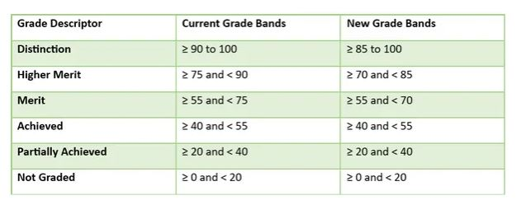
Junior Cycle State Exam Descriptors
The descriptors for subjects are Distinction, Higher Merit, Merit, Achieved, Partially Achieved and Not Graded.

Slide 38
External Subjects
Those who are studying a subject outside of school need to be aware of a few implications.
  Only a maximum of ten subjects can be registered for with the State Examinations Commission.
  You cannot complete any CBAs.
  You cannot complete the Assessment Task.

Slide 39
Queries
Please don’t hesitate to get in touch with us over any queries you may have.
For specific subject queries, students should ask their subject teacher in the first instance.
On the school site in the Parent section we have links to further information and background to the new Junior Cycle. These may be of help to some of you.

